Slide 1
Food tech innovation Cashew juice combined with various squeezed fruit juices naturally reduced sugar
Innovation Challenge
Tom Bouskila – BGU Shaked Hillel – BGU Henrique da Costa – UFC Eduardo Nunes – UFC
June 2023

Slide 2
Problem Identification - Israel
The problem: Shortage of healthy food at affordable prices in Israel
Causes:
Limited domestic production
High production costs
Market dynamics and competition
Lack of consumer demand and awareness
Effects:
Poor nutrition and health outcomes
Health disparities
Financial burden
Environmental impact
Restrictions:
Limited government support
Regulatory barriers
Import restrictions
Challenges:
Balancing cost and quality
Promoting consumer demand and education
Strengthening the local food system
People directly impacted:
Low-income individuals and families
Individuals with specific nutritional needs
Health-conscious consumers

Slide 3
Problem Identification - Brazil
The problem: High rates of hunger and food waste.
Causes:
Export-oriented market
Closure of family farming public programs
Economic crises
Effects:
33m people experiencing food insecurity
High prices in alternative diets
Environmental impact
Restrictions:
Limited government support
Regulatory barriers
High distribution costs
Difficulties in accessing credit for new businesses
Challenges:
Balancing cost and quality
Promoting consumer demand and education
Strengthening the local food system
People directly impacted:
People in poverty experiencing food insecurity
People with dietary restrictions
Owners of new businesses in the field

Slide 4
Objective Aimed at Solving the Problem
In Israel:
enhance the accessibility and availability of healthy food options.
implement measures that address the causes and effects of high-priced healthy food.
ensure that individuals, irrespective of their income, can access a diverse range of nutritious choices at affordable prices.
This can be accomplished through the following strategies:
- Government incentives for healthy food production.
- Consumer education on healthy nutrition.
- Collaboration between food chain owners, government, and farmers.

Slide 5
Objective Aimed at Solving the Problem
In Brazil:
To make food more accessible.
Promoting businesses that address the issue of food waste, especially when it comes to highly nutritious food.
This can be accomplished through the following strategies:
- Government incentives for healthy food production.
- Children education on healthy nutrition at school.
- University involvement in the research of new food forms.

Slide 6
Prevailing Knowledge and Existing Alternatives
Past experience in innovation in this field - in Israel
Agricultural Technology (AgTech) Startups
Community gardens and urban agriculture

Slide 7
Prevailing Knowledge and Existing Alternatives
Past experience in innovation in this field - in Brazil
PANC’s (The "Non-Conventional Food Plants Program”)
Sebrae and Embrapa

Slide 8
Prevailing Knowledge and Existing Alternatives Research Findings
Awareness of Market Potentials and Utilization of Cashew Fruit: Perspectives of Cashew Farmers in the Brong Ahafo Region of Ghana study highlights the need for government support to address the challenges faced by cashew farmers in accessing markets and processing cashew fruit
Evidences of the sustainable innovation in the cashew agribusiness context in ceará – brazil The review concludes that sustainable innovation is a key factor for the development of the cashew agribusiness in Ceará, Brazil.

Slide 9
Prevailing Knowledge and Existing Alternatives Research Findings
Several facts on the cashew apple:
The cashew apple is a highly perishable fruit often discarded during cashew nut processing.
The cashew apples contains a wide range of nutrients, and it is rich in bioactive compounds.
The cashew is a rich source of vitamin C, supporting immune system function.
Cashew apple residues offer diverse applications across multiple industries.

Slide 10
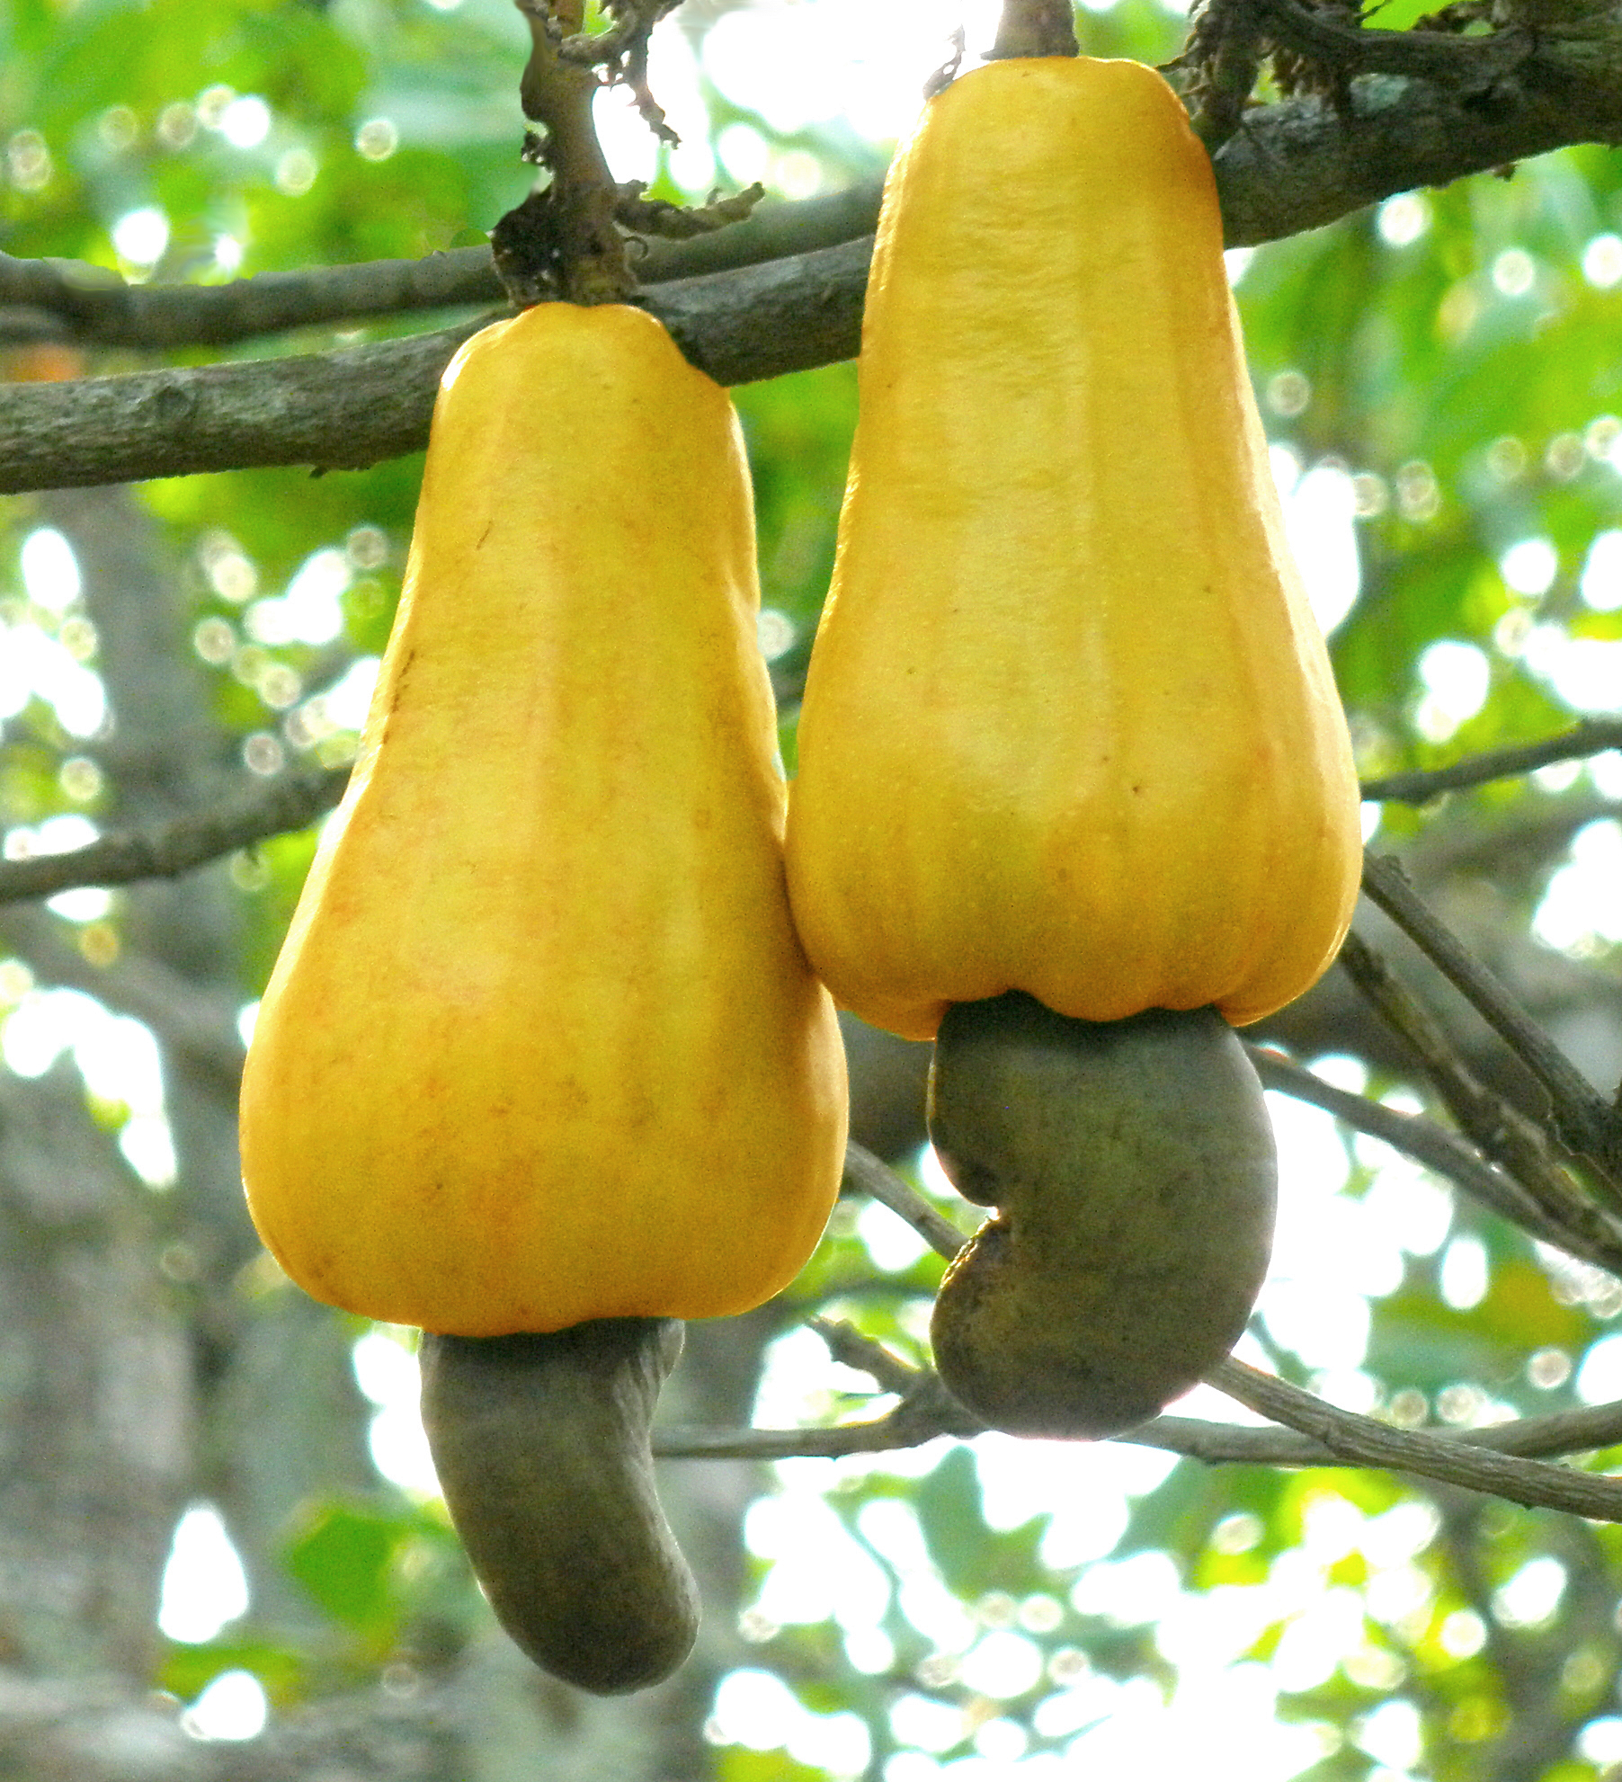
Proposed Innovation Collaborative Idea
Cashew juice combined with various squeezed fruit juices from fruits grown in Brazil combined with the Israeli technology of naturally reducing sugar from the fruit, which makes the juice healthier without changing the taste.

Slide 11
Typology of the Innovation Idea
Technological innovation – based on joint R&D
Incremental innovation – the idea of blending fruit juices and reducing sugar levels is not a radical departure from existing practices.
Sustaining innovation - enhances existing juice products by reducing sugar levels using Israeli technology.
Open innovation - cooperation with other juice producers and collaboration between Israel and Brazil

Slide 12
Implementation Guidelines: The Ecosystem
Research and Development
Supply Chain and Sourcing
Production and Manufacturing
Marketing and Distribution
Regulatory Compliance
Funding and Investment
Collaboration and Networking
Continuous Innovation and Improvement

Slide 13
SWOT Analysis
Strengths:
Technological Expertise
Rich Agricultural Resources
Unique Product Combination
Market Potential
Cultural Exchange
Opportunities:
Health-Conscious Consumer Trends
Export Potential
Diversification of Product Portfolio
Weaknesses:
Geographic Distance
Limited Knowledge Transfer
Market Competition
Threats:
Regulatory Compliance
Economic Factors
Intellectual Property Protection

Slide 14
Economic Evaluation
Markets
Costs
Revenue
Employment

Slide 15
Expected Regional Long-Term Impacts
Job Creation and Economic Growth
Supply Chain Development
Market Expansion
Knowledge Transfer and Technological Advancement
Research and Development
Strengthened Business Relationships

Slide 16
Conclusion
This entire movement is already happening in a timid and poorly organized way.
The interest in plant-based products is already significant in foreign markets.
The obstacles can be systematically resolved through public policy, by creating a space for entrepreneurs, consumers, and researchers to interact. Brazil already has a good example: the National School Feeding Program (PNAE). This program promotes education through food, supporting small-scale producers and encouraging the consumption of healthy foods.
Together, these individuals have the potential to change the world of food.

Slide 17
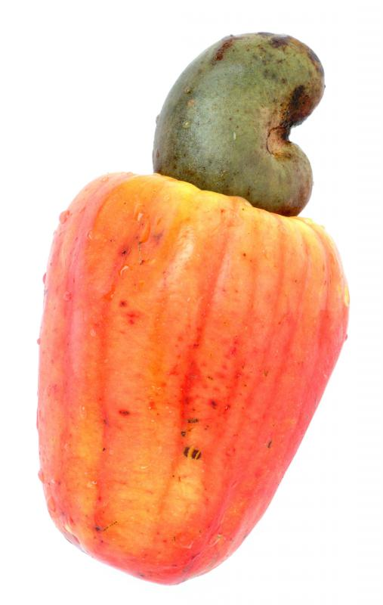
Recommendations
Utilize existing innovation environments such as Sebrae in Brazil.
Incorporate academia into the process, promoting new discoveries and possibilities.
Transfer knowledge; Israel has a long history of extreme utilization of food, and Brazil can develop new techniques based on various products not found in Israel.
It could be an extraordinary collaboration!

Slide 18
Thank You!

