Slide 1
Promoting innovation in SMEs with a new model of Reverse Mentoring
Dafna Schwartz* , Raphael Bar-El** and David Bentolila***
*Reichman University & Peres Academic Center; ** Ben Gurion University & Sapir Academic College;*** Ruppin Academic Center
Innovation as an Instrument for the Promotion of Non-technological Firms Roundtable
Federal University of Ceara (UFC), Fortaleza, Brazil, July 18-24, 2023
The project was sponsored and initiated by FIEC under the Presidency of Roberto Proença de Macêdo , and conducted by Carlos Matos Lima, Pedro Sisnando Leite, Monica Clark Cavalcante and the FIEC personnel
Schwartz, D., Bar-El, R. and Bentolila, D.J. (2022). "Adapting Reverse Mentoring Strategy to SMEs: A New Pilot Model Implemented in Brazil“
, Sustainability, 14(15), pp.9515. https://doi.org/10.3390/su14159515

Slide 2
What is Reverse Mentoring (RM) programs?
In traditional mentoring programs, the older, more experienced employees act as mentors for the junior employees.
In RM programs the hierarchy is flipped.
The junior employees act as mentors to senior employees, providing them with updated technology and latest trends.
(Chaudhuri et al., 2022; Chen, 2013; Chen, 2020; Gadomska-Lila, Jordan and Sorell, 2019; Garg and Singh, 2019; Mortimer, 2015; Murphy, 2012; 2020; Sanghamitra et al, 2022 Schwartz, Bar-El & Bentolila, 2022; Wingard, 2018 )

Slide 3
This interaction
Stimulates the companies to promote innovation
by adapting its strategy to current trends and technology.
With lower cost and effort.
These programs has become popular in recent years with large companies for promoting innovation.
(Chaudhuri et al., 2022; Jammulamadaka, 2021; Jordan and Sorell, 2019; Raza, 2020; Wingard, 2018)

Slide 4
However, RM programs are not Implemented by SMEs
Even though they could benefit from them, due to:
Their size disadvantage.
Lack of qualified junior employees that can take on this role (Bilan, et al., 2020; Hasman, Schwartz and Bar-El, 2013).
Lack of organizational capabilities
Lack of financial resources.
(Garengo & Bernardi, 2007; Harel, Schwartz & Kaufmann, 2020).

Slide 5
The current study presents a New RM Program
That is applicable also by SMEs.
A pilot project was implemented in Ceara in 2014 by FIEC demonstrates its feasibility.

Slide 6
Professional external organization
Selection of target companies
External Juniors
- university graduate students
In each company Select :
a team of senior employees
Technology, Perspectives, , trends, etc.
Company A
Company B
Training in innovation
Company C
Innovation Agents
Promoting innovation

Slide 7
The New RM program was executed by an external organization
It was executed by FIEC in several companies simultaneously instead of by each company individually.
And this creates economies of scale.
(Bar-El, 2014; Schwartz & Bar-El, 2014; Schwartz, Bar-El & Bentolila, 2022).

Slide 8
The Juniors were not junior employees
But university graduate students with specialization in innovation that were recruited for this program.
They Were titled Innovation Agents.
They received training in the field of innovation and about their role.

Slide 9
The Innovation Agents role was
To provide the senior employees with new and "fresh" perspectives and updated technology
To support the companies for accessing external information and optimizing the use of the local ecosystem.

Slide 10
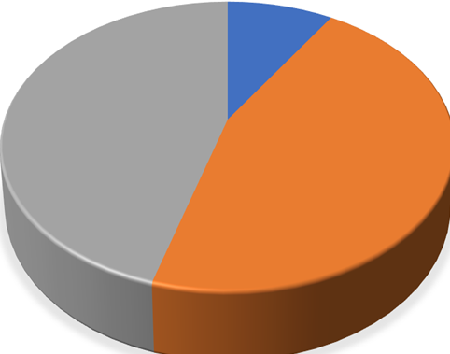
The implementation Phase
22 companies were selected by FIEC.
Most of them – about 90% were SMEs.
Each company appointed an innovation team that consisted of one or more senior employee.
SMEs

Slide 11
A team of IA were appointed for each company
Each IA team approached a company
and paired with the company’ innovation team.

Slide 12
Main Findings

Slide 13
In All the Companies, the IAs Assisted in:
Identified new directions for promoting innovation.
Main areas:
Developing new products
Improving innovation processes (recycling, logistics, energy alternatives and more)
Identifying new markets
HR development

Slide 14
For all the Companies, the IAs Identified
External entities of the ecosystem that the company should approach which could assist in implementing the new directions.
In many cases they also proposed how to approach these entities and assisted in connecting with them.

Slide 15
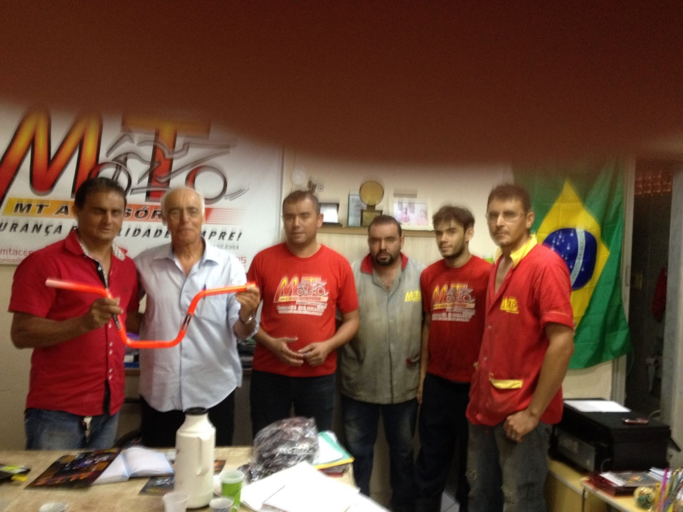
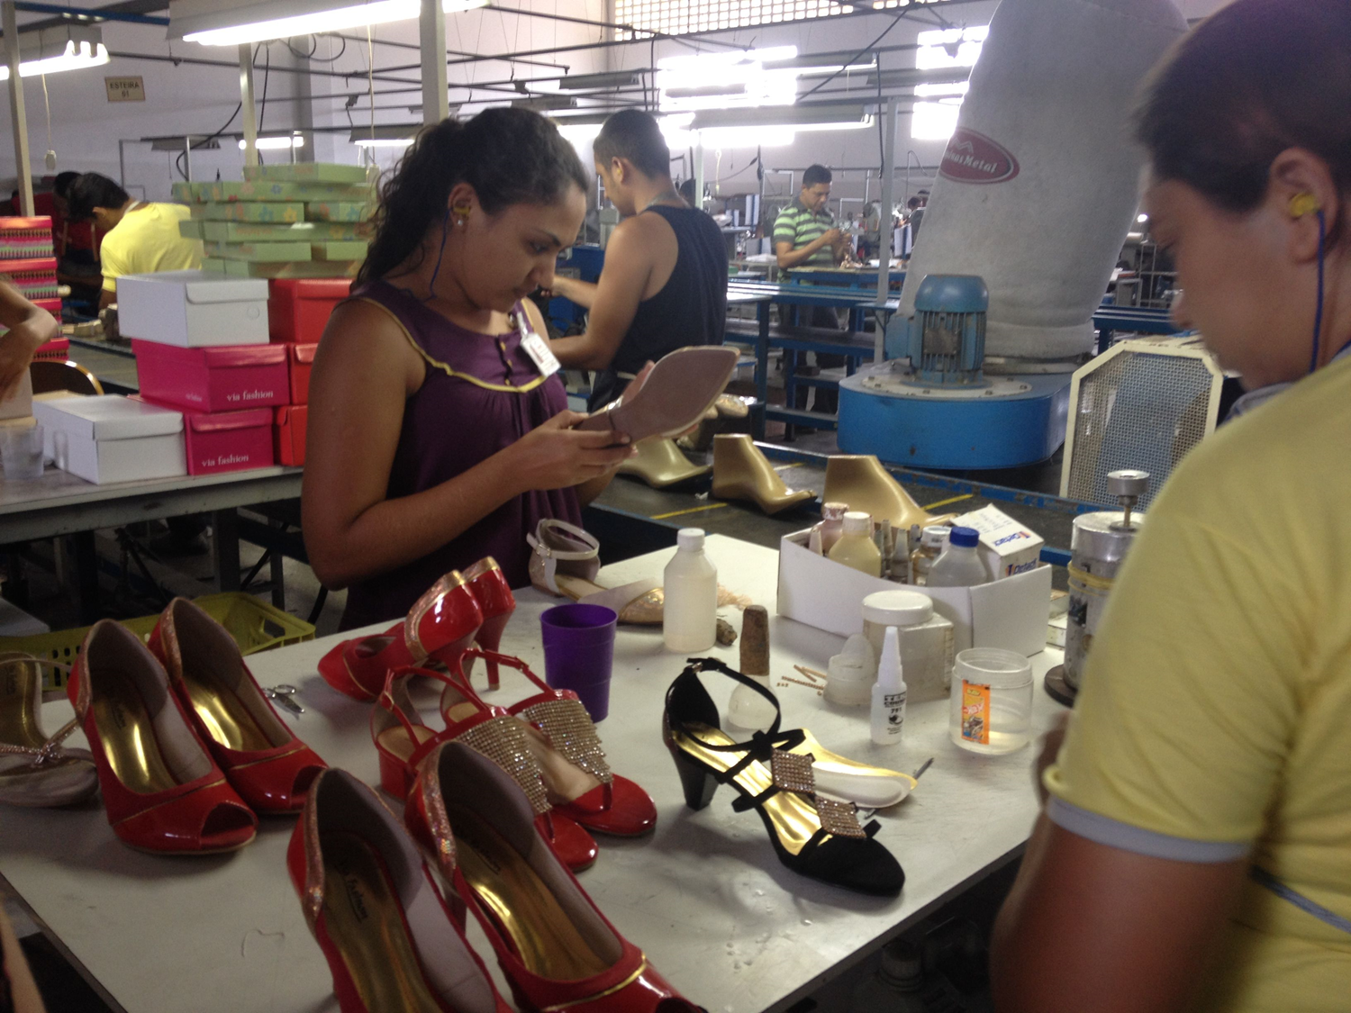
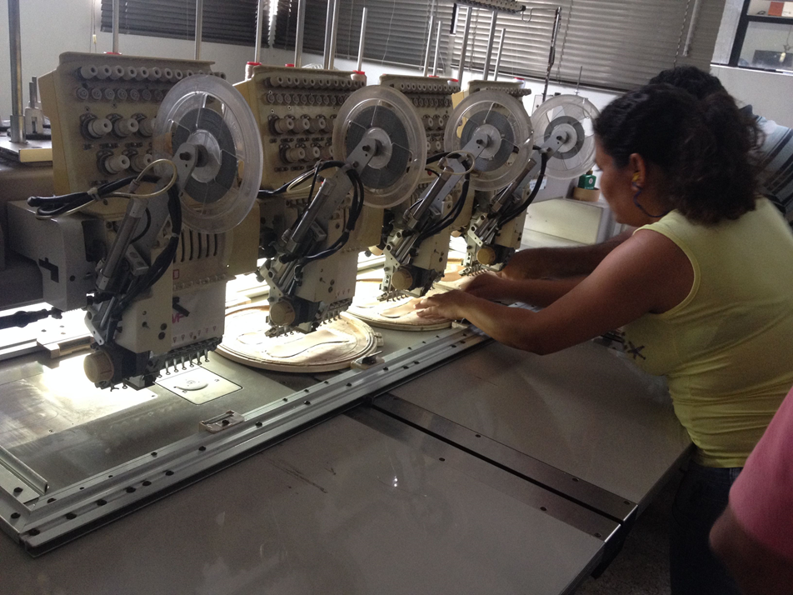
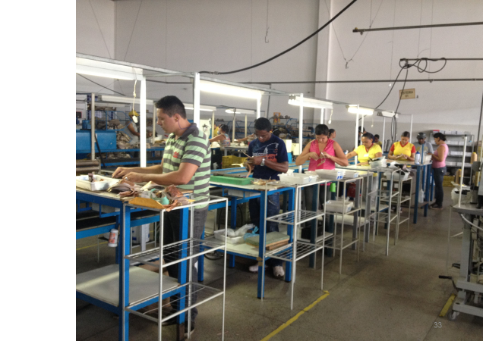
Selected examples of companies that participated in the program.
The Innovation Agents visit the companies.

Slide 16
The Program Contribution in Retrospective
In 2021, we conducted a focus group to get retrospective feedback on the program contribution.
The focus group consisted of representatives of the bodies that participated in the ilot project.
(2 Innovation Agents, company manager, FIEC representatives, and the advisory committee for the program)

Slide 17
They confirmed that the program
Contributed to the companies, and gave examples :
A company that expanded its activities dramatically
Companies that Improved their processes
A company that entered new markets
Companies that expanded their networking with other entities of the ecosystem
The IA, who were at that time university graduate students, the program helped them gain experience in industry.

Slide 18
The impact – The new RM program has gained global recognition
Published in professional articles and journals.
Presented at numerous prestigious conferences worldwide.
Recognized in Israeli press as a model to foster innovation.
Integrated into universities teaching programs.
And to practicum programs, preparing students for the labor market.
Implemented in international projects, including our involvement in the UNDP project in Ethiopia.
We've received implementation inquiries from companies and organizations like the Teacher Training Center and the Israeli Ministry of Defense.

Slide 19
Conclusion - The new RM program
Is applicable not only to large companies but also to SMEs.
The program has made a significant contribution to promoting innovation within companies.
The program has gained global recognition.

Slide 20
Recommendation for Further Research
The pilot study was based on an experiment, conducted on a few non-representative companies.
The model deserves more in-depth research and should be based on a greater number of companies, with a wider distribution of sizes, types of activity and locations.
Schwartz, D., Bar-El, R. and Bentolila, D.J. (2022). "Adapting Reverse Mentoring Strategy to SMEs: A New Pilot Model Implemented in Brazil“
, Sustainability, 14(15), pp.9515. https://doi.org/10.3390/su14159515

Slide 21
Acknowledgments:
We are deeply thankful to the leaders of the Federation of Industries of Ceara (FIEC) (Federacao das Industrias do Estado do Ceará), especially to his President: Roberto Proença de Macêdo and his team, to Carlos Matos Lima the Director of the National Institute for Industrial Development (INDI) and to his team within the UNIEMPRE program. Special thanks to to Prof. Pedro Sisnando Leite and to Mônica Clark Cavalcante who provided an invaluable professional and personal support, and to FIEC personal and of course to all participants in this project.

Slide 22
This Photo by Unknown Author is licensed under CC BY-NC

