Slide 1
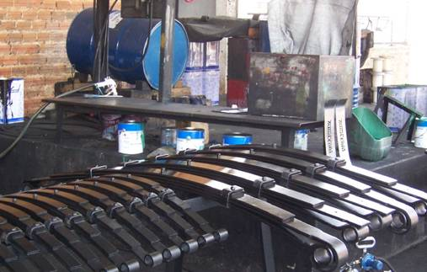
Promoting the innovation ecosystem in the periphery:
insights from the experience in Ceara
David Bentolila
Ruppin Academic Center
Roundtable BGU- UFC
Innovation as an Instrument for the Promotion of Non-technological Firms Fortaleza, Brazil, July 19-24, 2023
The project was sponsored and initiated by FIEC under the Presidency of Roberto Proença de Macêdo , and conducted by Carlos Matos Lima, Pedro Sisnando Leite, Monica Clark Cavalcante and the FIEC personnel
Cariri
06/08/2014

Slide 2
Development of innovation requires a supporting ecosystem
Such an ecosystem usually develops in urban areas.
How can an ecosystem of innovation be developed even in the peripheral areas?
A pilot of ecosystem development in peripheral areas was carried out in the state of Ceara.
It seems that we can learn from him also about the future

Slide 3
Breaking the GAP between the periphery and the Capital
Gathering leaders, industries interested in Innovation, government institutions, regional universities, financing groups, local municipalities

Slide 4
The Regional Innovation Center - RIC – “POLO de inovacao”
Regional Innovation tool, aims to empower the region.
Formation of social capital: articulation of actions between various innovation institutions.
Encouragement of innovation dynamism: identify local potencial and attracting investment.
Identify potential problems: take action to overcome issues.

Slide 5
How?

Slide 6
Structure of the Regional Innovation Center - RIC
Universities in the region
Industries in the region
Relevant Core Industries – like the Nucleos below
Examples: UFC, IFCE
State institutions of the innovation ecosystem
Regional institutions of the innovation ecosystem
Regional Advisory Board
Examples: SEBRAE,
Examples: CENTEC, FIEC
Innovation Center
Agrifood
Shoes
Ceramics
Cement and Mining
Confection
Mechanical metal
Sectorial Core 1
Coordinator
Sectorial Core “n”
Sectorial Core 2
Sectorial Core 3

Slide 7
The Regional Advisory Board serves as a forum for the discussion of fundamental issues for the promotion of innovation in the region and in the center's management.
The Chairman of the Board is one of the region's industrial leaders.
The Advisory Board has representatives from the region's entities:
- regional industries
- Leaders of regional companies interested in stimulating innovation
- Regional Universities - Educational and research institutions.

Slide 8
Relationship Region - State
Institutional articulation between Regional Board and Management Group;
Operational articulation between Sectorial Cores and State Projects;
REGION
STATE
Regional Advisory Board
Management Group
institutional articulation
Conselho Regional
Innovation Center
Coordinator
Sectorial Core 1
Sectorial Core “n”
State Project 1
State Project”n”
operational articulation
Sectorial Core 2
Sectorial Core 3
State Project 2
State Project 3

Slide 9
Main Attributions of the Regional Innovation Center -1
Mapping the relevant profile of the region regarding innovation
Relationship between municipal and regional entities related to innovation
Relationship between companies and regional universities
Formation of the Advisory Board
Select a dynamic coordinator that enables the interaction and cooperation between all these institutions

Slide 10
Main Attributions of the Regional Innovation Center- 2
Creation of Thematic Groups – Sectorial Cores
“Reach-out” to detect suitable companies for innovation
Implementation of the Innovation Agents Project in the region
Implemention of Innovation Teams in monitored companies
Support companies in order to respond to innovation proposals
Organization of regional events with innovation themes
Collection data about results and measurement model

Slide 11
Bring suitable financial and professional assistance
Breaking the Gap

Slide 12
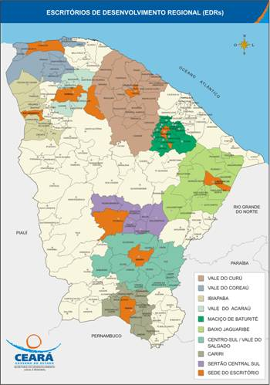
Two Regional Innovation Centers have been implemented –in Baijo Jaguaribi and in Cariri
Baijo Jaguaribi
Region
Cariri
Region

Slide 13
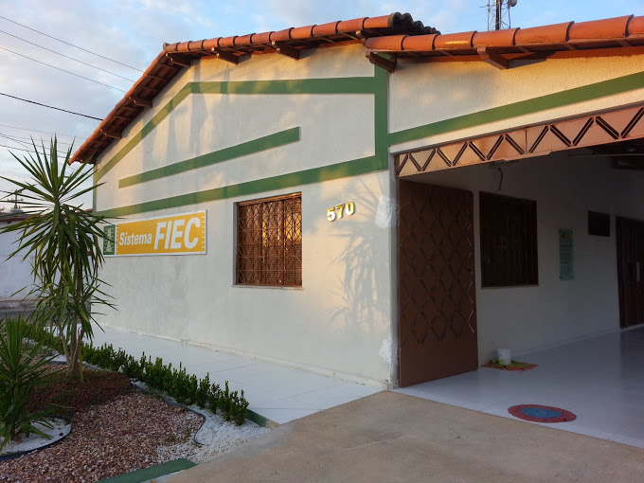
Polo do Jaguaribe

Slide 14
Innovation Agents – a crucial element in the Innovation Center
10 Companies monitored by 2 pairs of Agents.
More than 30 demands identified.
Demands forwarded to SENAI and IEL.

Slide 15
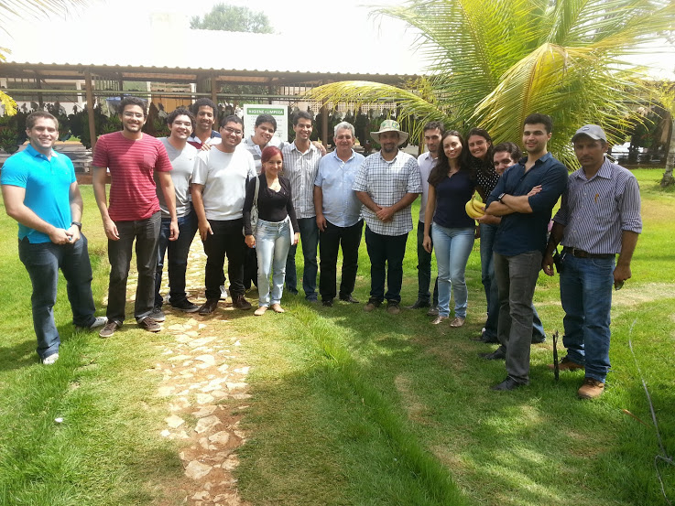
Innovation Agent

Slide 16
Events Organized
Inauguration of the House of Industry –Baking Course with SENAI's Mobile Unit (250 Students) –
InovaVale event - Sectors Facing the Future

Slide 17
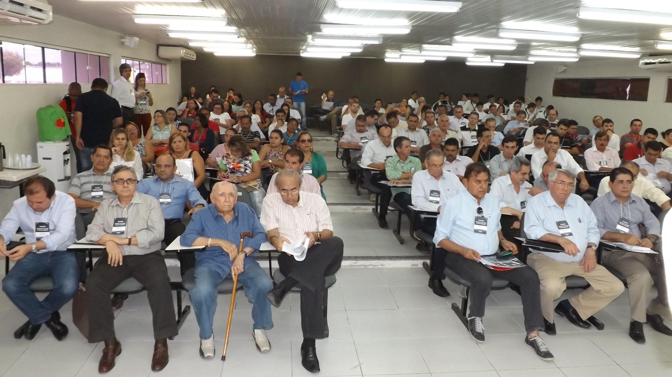
Auditório do CVT de Russas - lotado

Slide 18
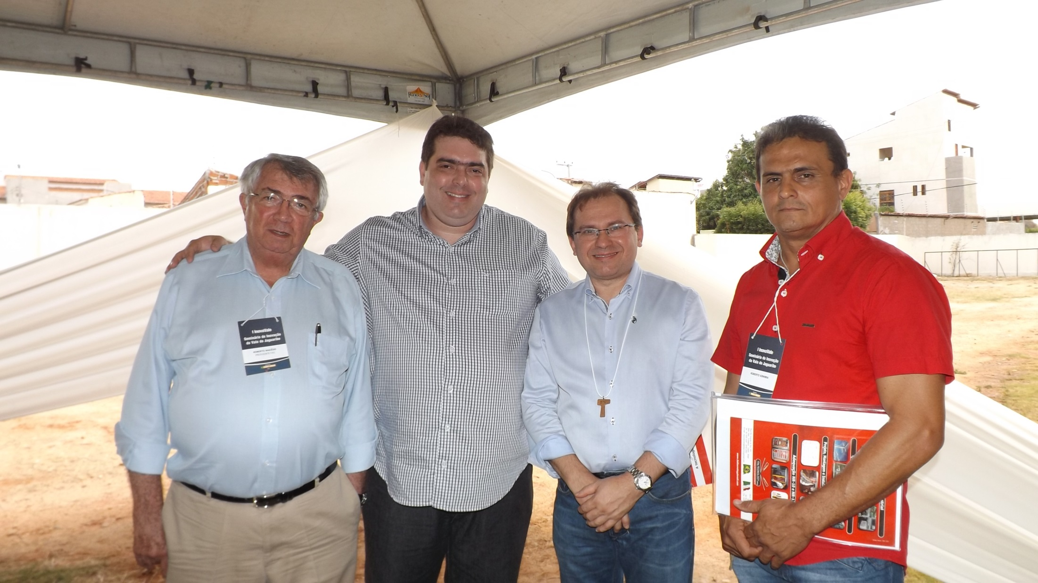
Bate-Papo dos empresários da região com o Presidente Roberto Macêdo e Carlos Matos

Slide 19
Sectorial Cores (nucleos)
6 Sectorial Cores:
Agrifood
Shoes
Ceramics
Cement and Mining
Confection
Mechanical metal

Slide 20
InovaVale - September
WorkShops:
Credit and Financing
Thematic Meetings:
Energy Efficiency
Infrastructure and Logistics
Productivity.
Business roundtable.

Slide 21
Other Actions
IFCE Incubator
- Support in the elaboration.
- Board Membership.
Sector Events:
- InovaMetal
- InovaAgro

Slide 23
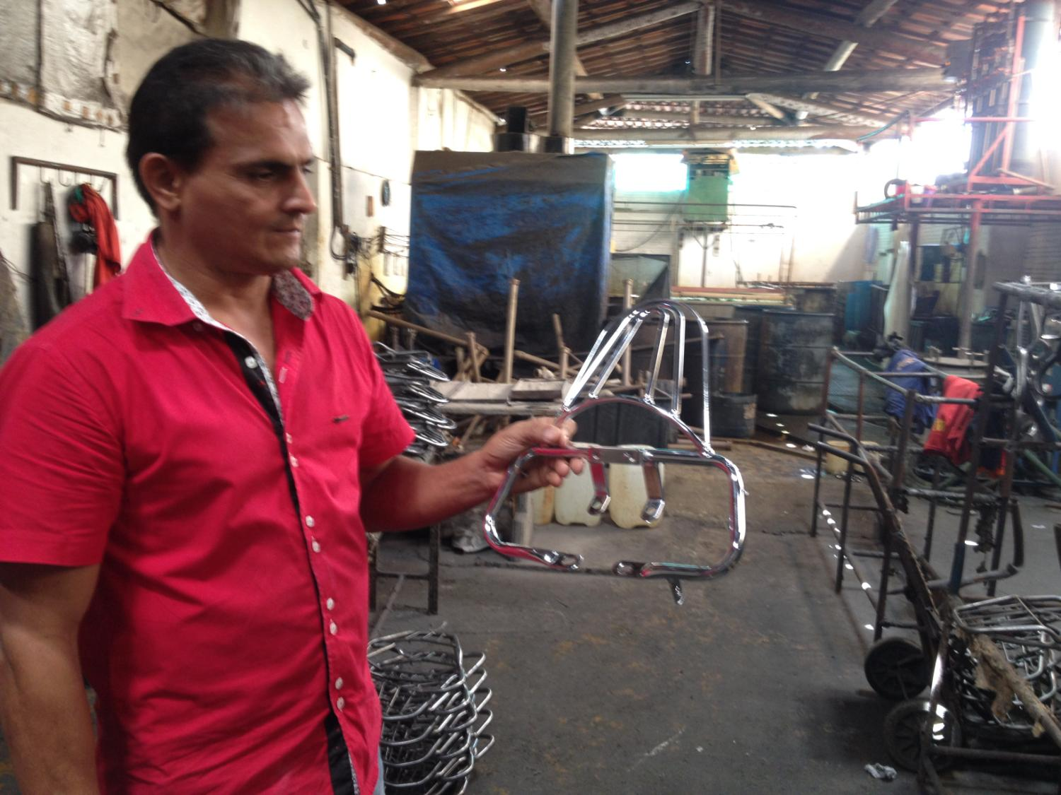

Slide 24
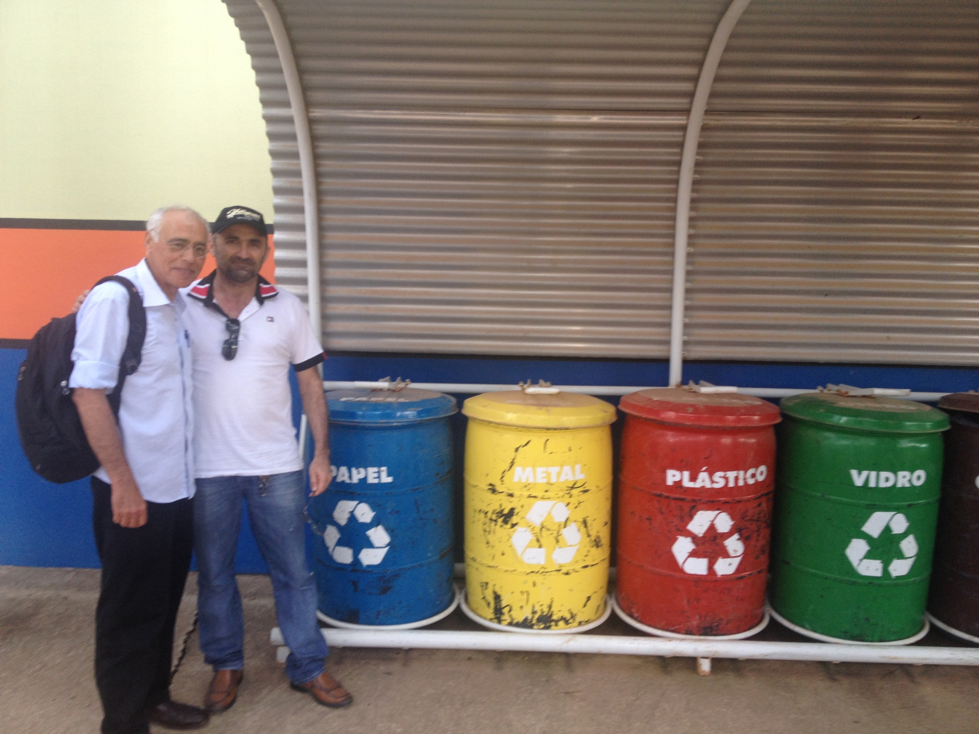
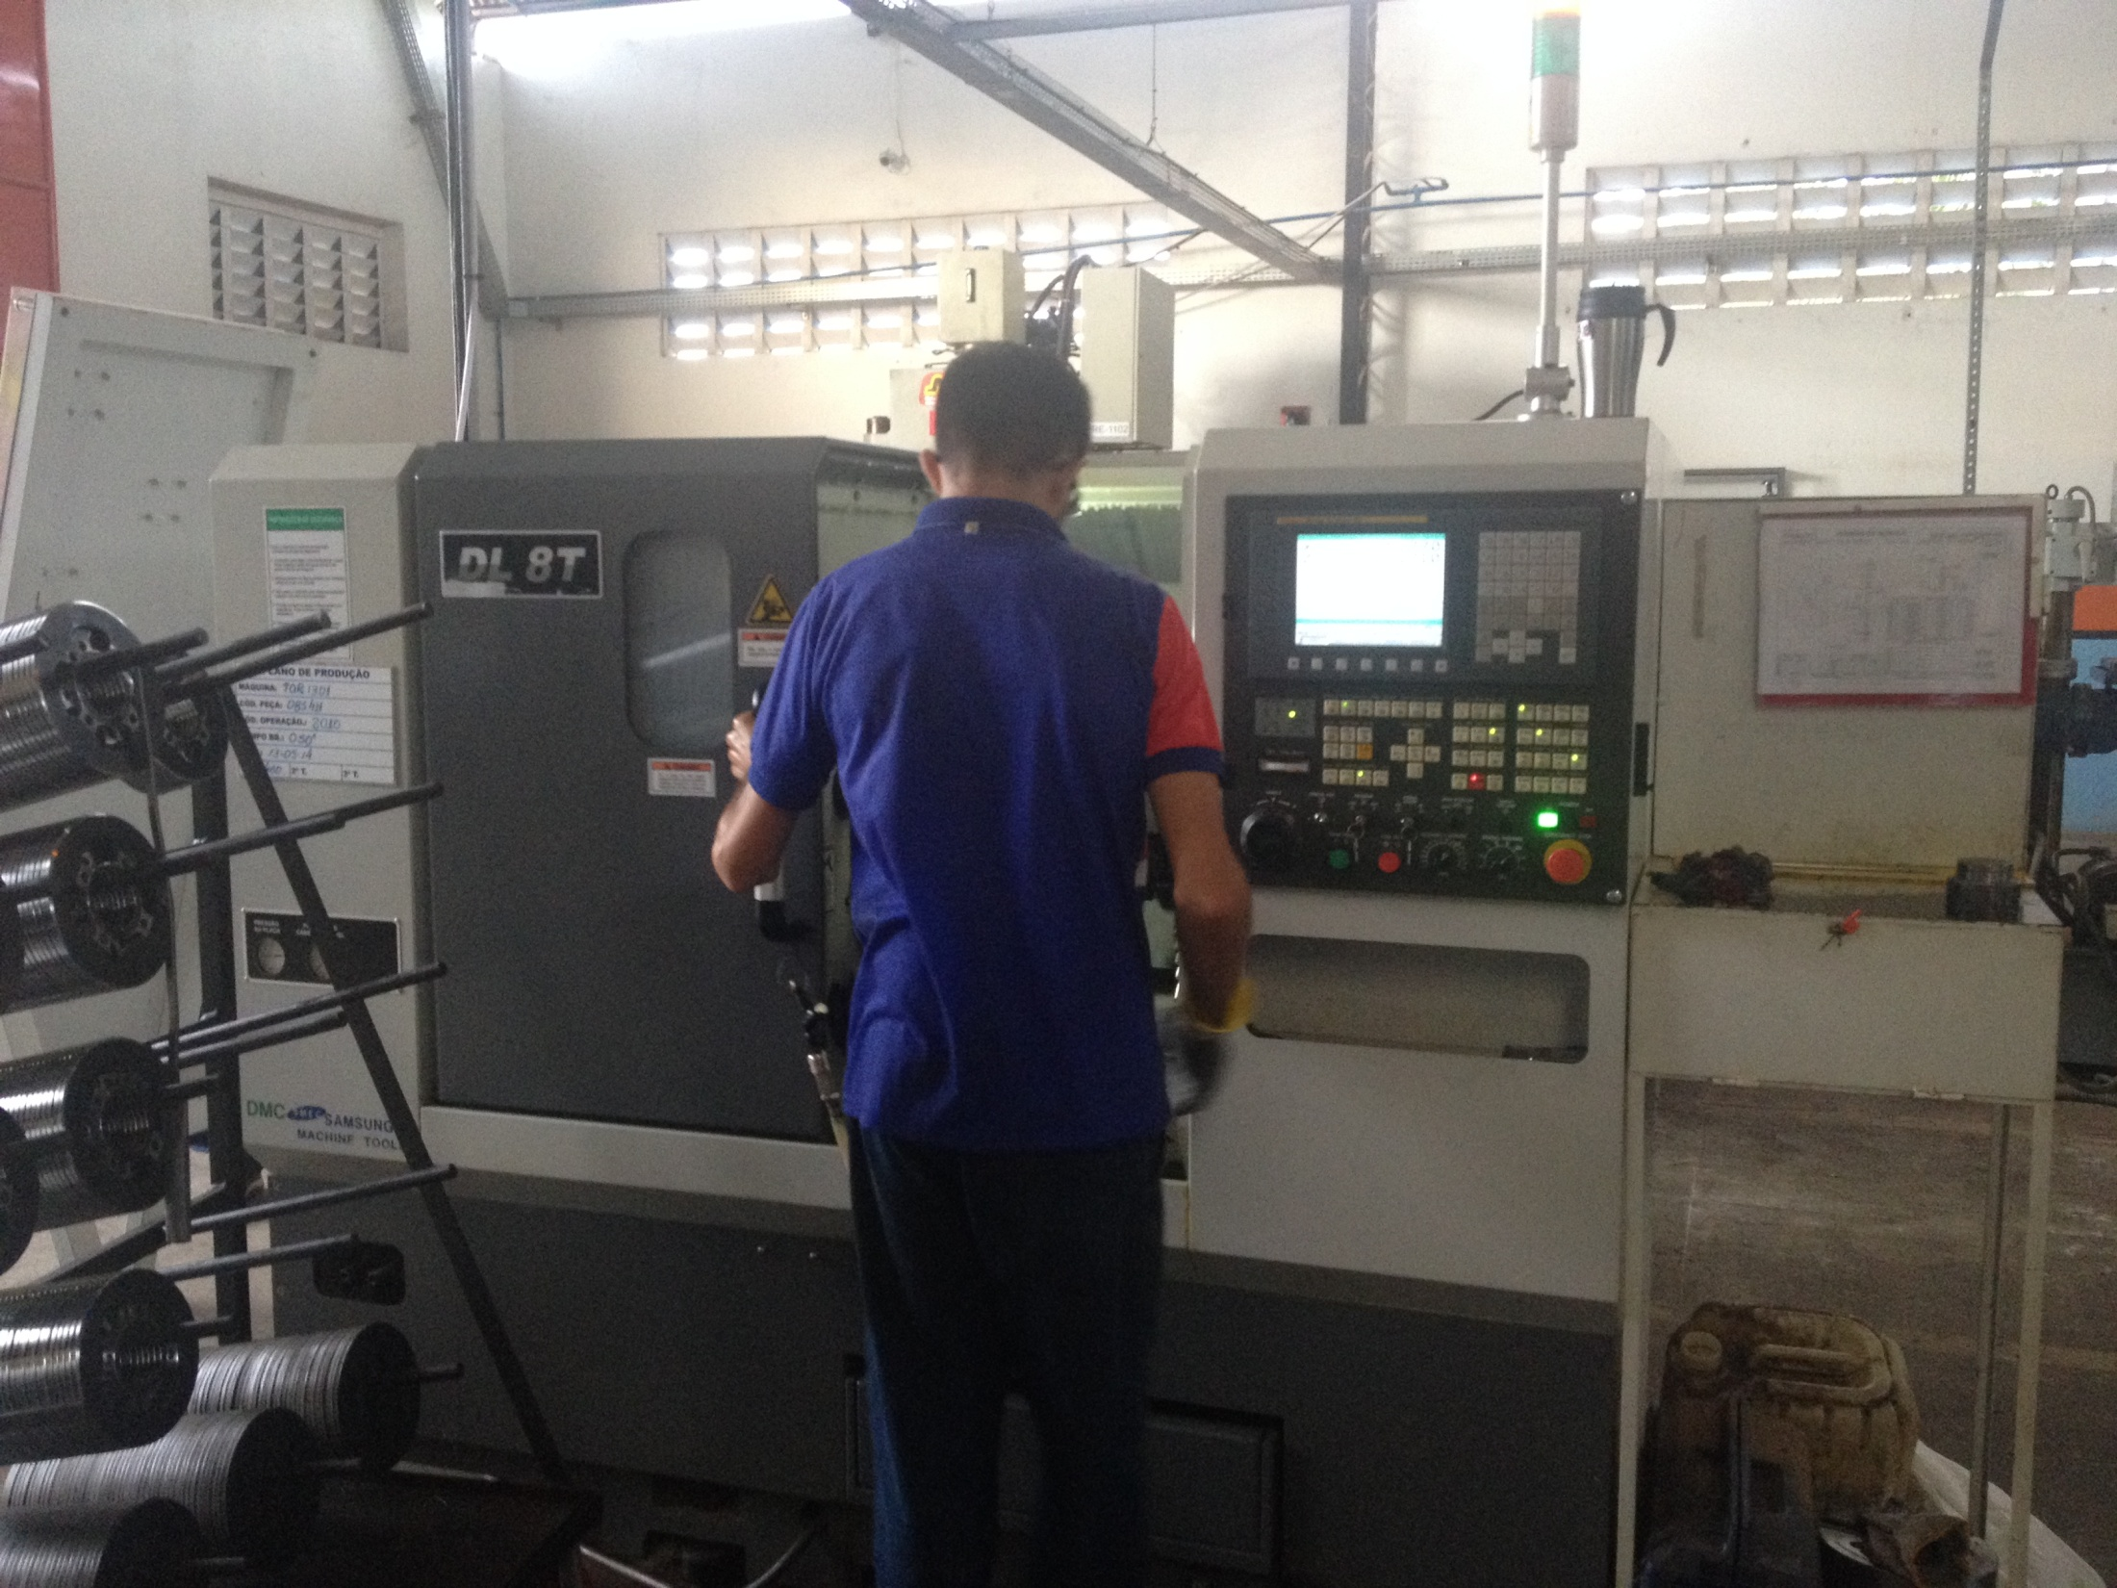
Example
Gear and chain kits for motorcycles

Slide 25
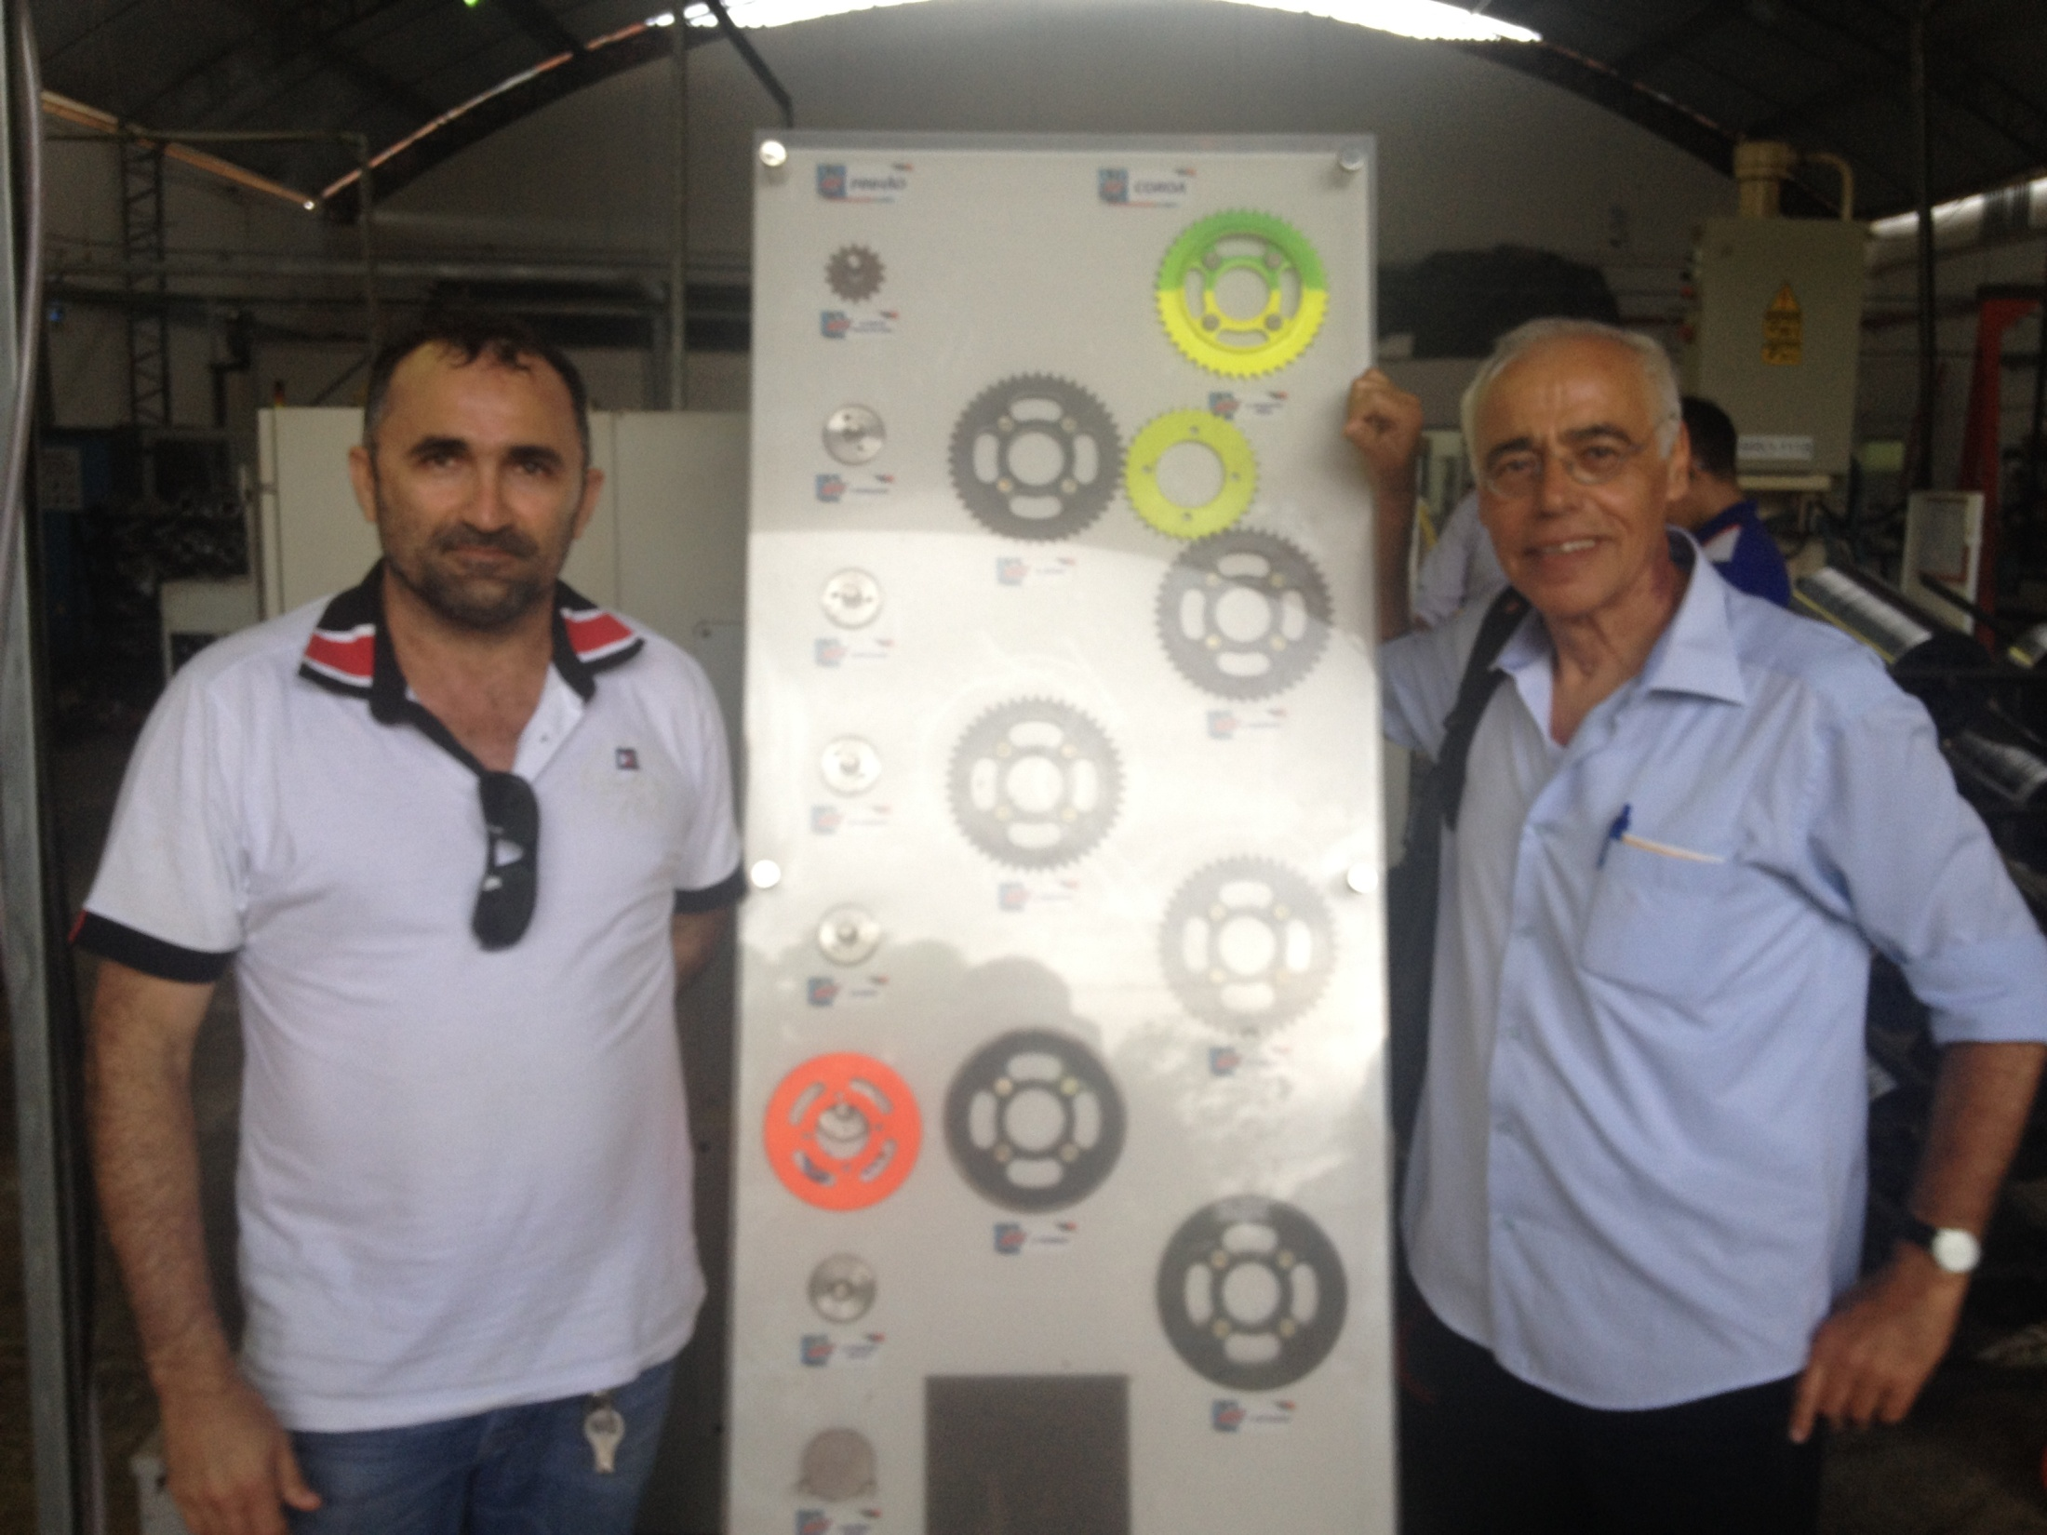

Slide 26
Example
Shoes Manufacturing

Slide 27
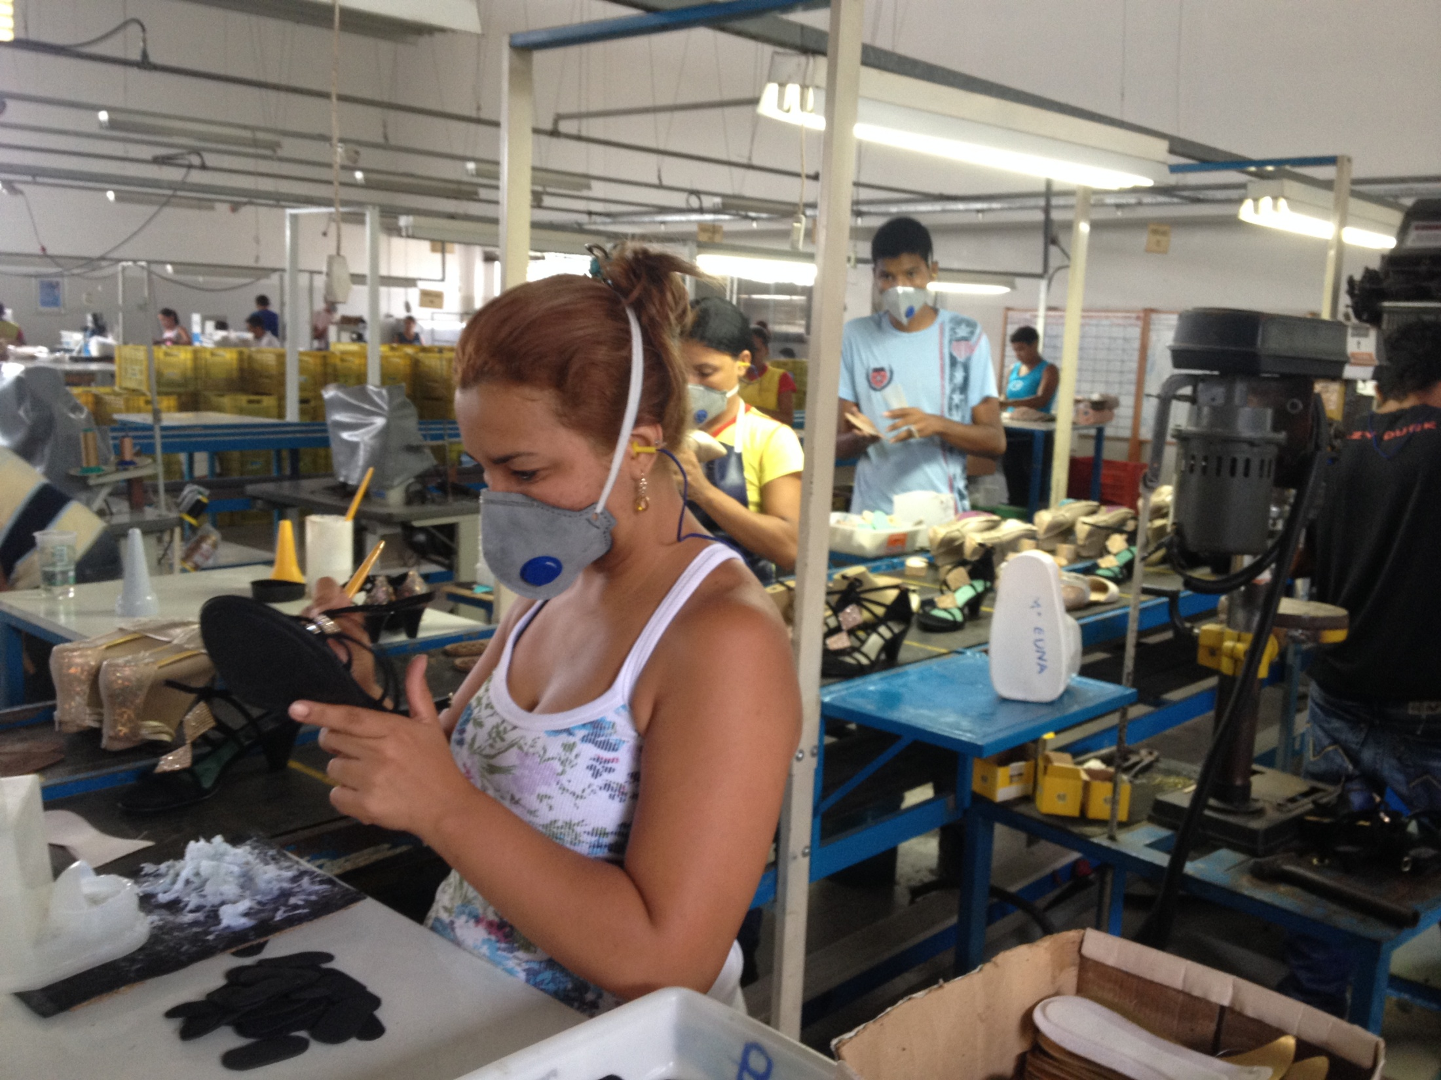
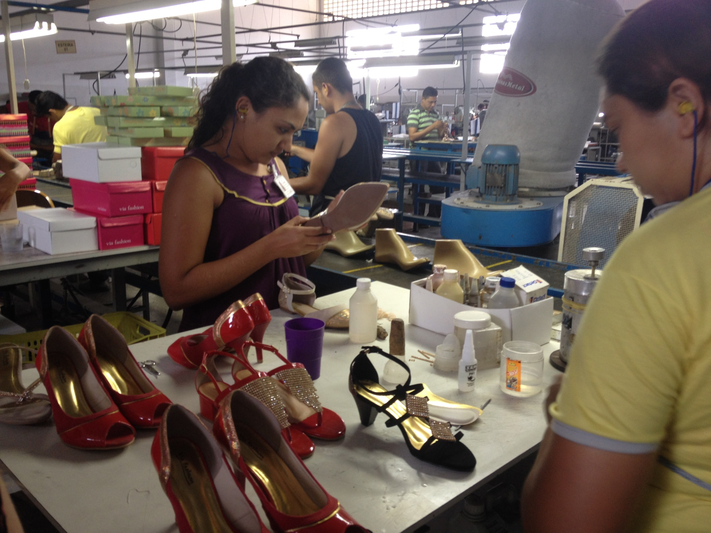

Slide 28
Example
Jewelry production – gold plating

Slide 29
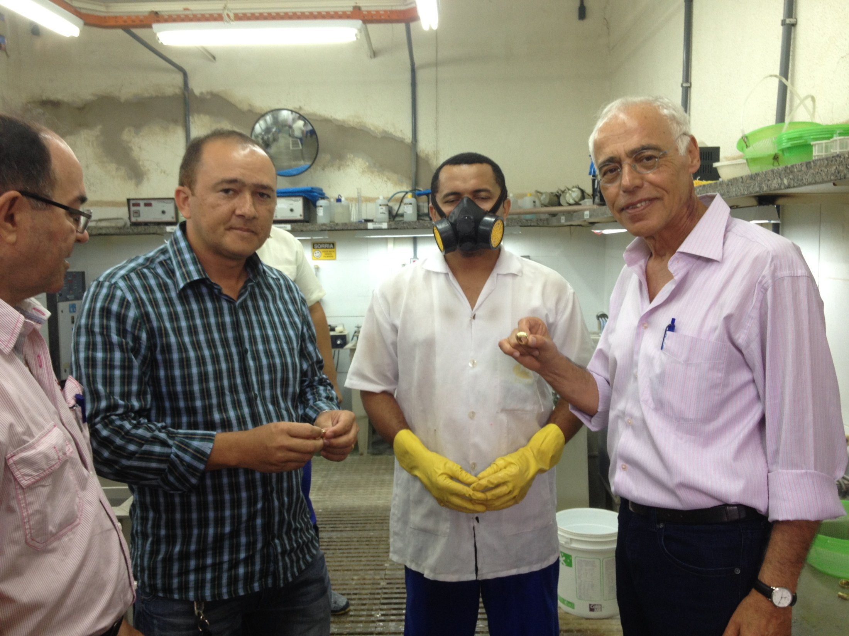

Slide 31
Recognition of the RIC model
The Regional Innovation Center model have been incorporated in academic entrepreneurship and innovation courses.
Another latin amrican state has shown deep interest in the model and invited an academic team from Israel to study possibilities of implementation in the country.
It can be elaborated for implementation in other regions in Ceara, in more states of the Nordeste and in countries with goals of implementing innovation in the periphery.

Slide 32
Aknowledgements
We are deeply thankful to the leaders of the Federation of Industries of Ceara (FIEC) (Federacao das Industrias do Estado do Ceará),
To his President: Roberto Proença de Macêdo and his team, To Carlos Matos Lima, the Director of the National Institute for Industrial Development (INDI) and to his team within the UNIEMPRE program.
Special thanks to to Prof. Pedro Sisnando Leite and to Mônica Clark Cavalcante who provided an invaluable professional and personal support,
And to all participants in this project.

Slide 33
Questions?
Thank You!

