Slide 1
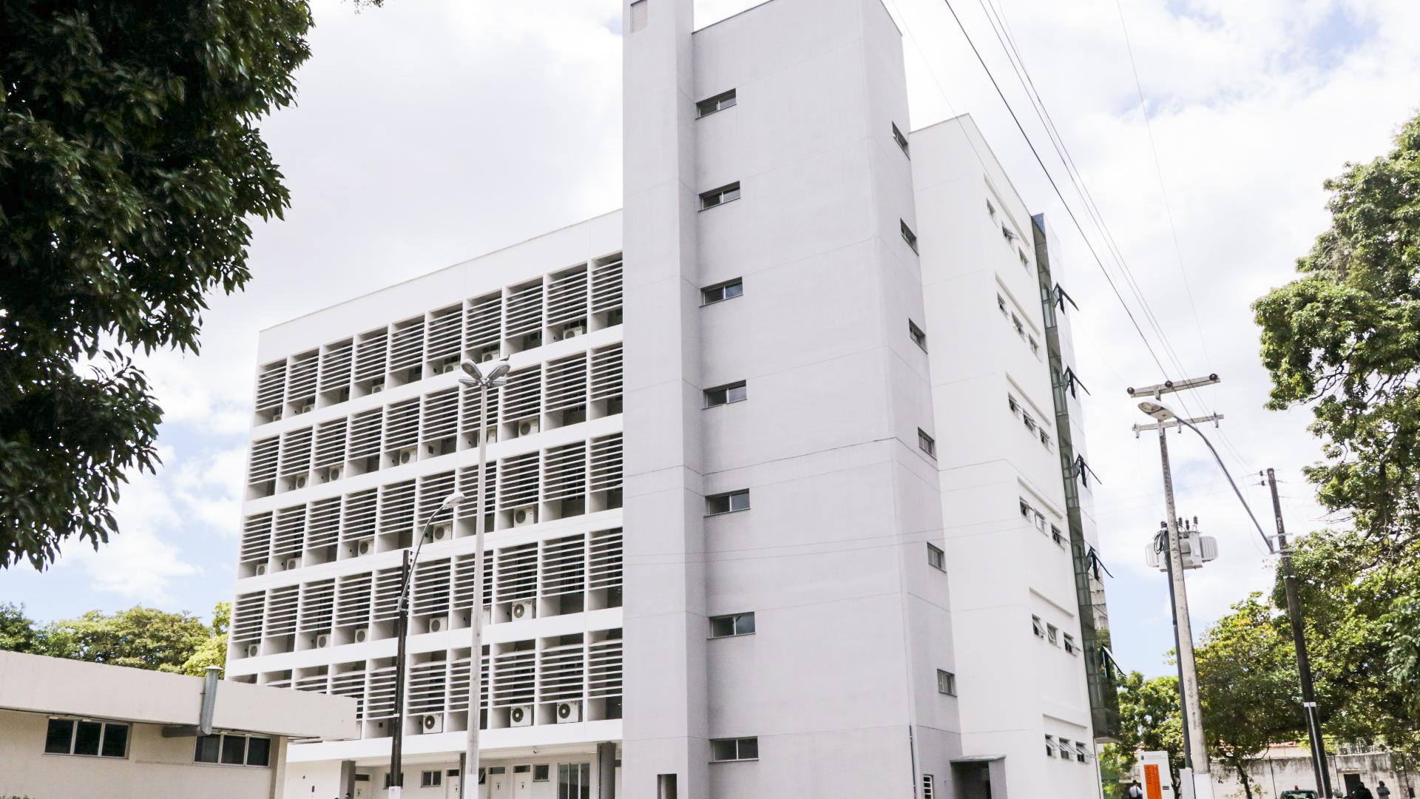
CONDOMÍNIO DE
EMPREENDEDORISMO
E INOVAÇÃO
CONDOMÍNIO DE
EMPREENDEDORISMO
E INOVAÇÃO
ENTREPRENEURSHIP
AND INNOVATION HUB

Slide 2
Undergraduate
Students
Broker
Graduate
Students
Our
business
Unite
Entrepreneurship
Our
mission
Researchers
Faculty and Staff
Converge
Innovation
Our
players
Public
Sector
Foster
Connect
Academic
Community
Private
Sector

Slide 3
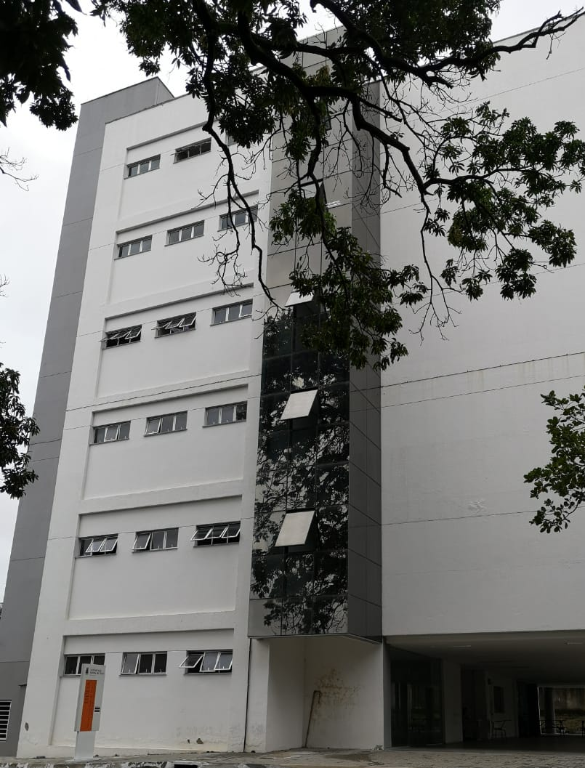
OUR
FACILITIES
5th Level
Reference Center in Artificial Intelligence
4th Level
Coworking Spaces for Junior Enterprises
University Spinoffs
3rd Level
School for Academic Development and Innovation (EIDEIA)
Visiting Professors Office
Technology Transfer Office (UFCInova / CIT)
HQ of UFC’s Technology Park
Project Management Office
2nd Level
Coworking Spaces for Startups
Coordinating Office for Entrepreneurship
Coordinating Office for Institutional Innovation
Convergence Office (FIEC, SEBRAE, ETC.)
1st Level
Training Center
Multi-user Convention Center

Slide 4
PROJECTS
CONDOMÍNIO DE
EMPREENDEDORISMO
E INOVAÇÃO

Slide 5
Partner Hubs

Slide 6
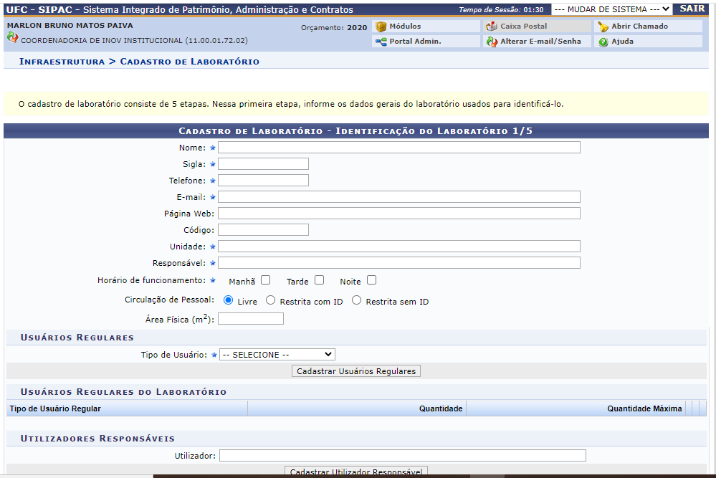
LABORATORY MAPPING PLATFORM

Slide 7
PROJECT MANAGEMENT
OFFICE
Guidance and assistance to UFC researchers about the legal resources that best fit their demands;
Facilitation of the relationship between researchers and private or public companies;
Qualified entry and correct instruction on document processing;
Facilitation of the flow and approval of projects.

Slide 8
TECHNOLOGY TRANSFER OFFICE
450 patent applications;
we recently ranked fourth in depositors in Brazil
During the last 4 years, at this administration, we registered 50 softwares and we had 46 patents granted;
About commercialization, we have 2 patent licenses that generated more than 100 thousand reais in royalties for the university and inventors;
We attracted +200 million reais investments in R&D from 2018 -2022;

Slide 9
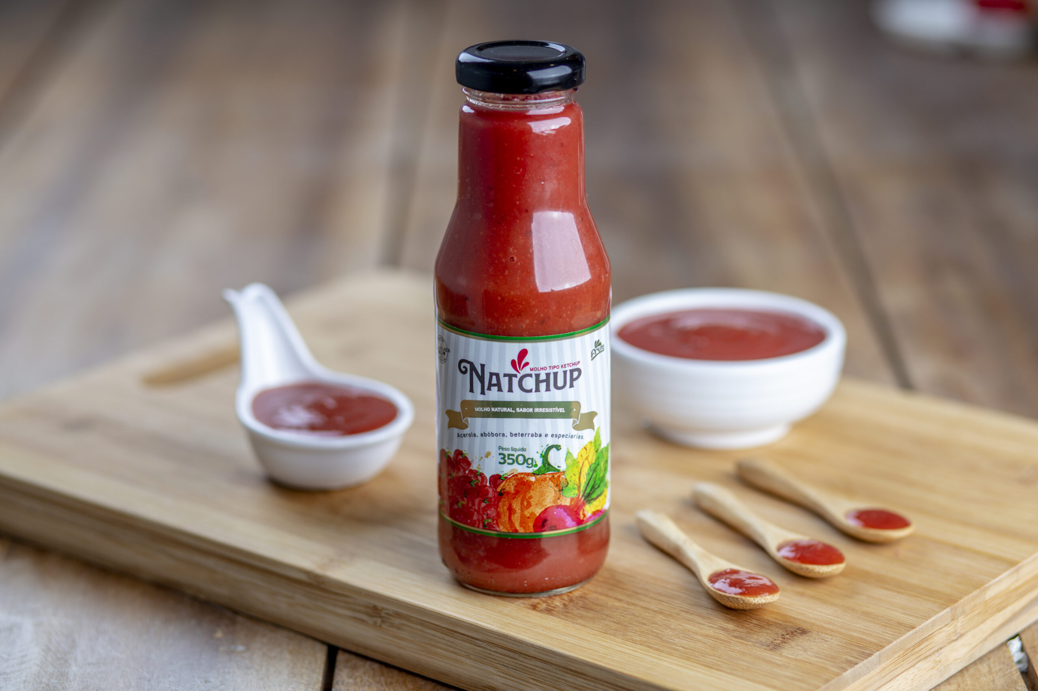
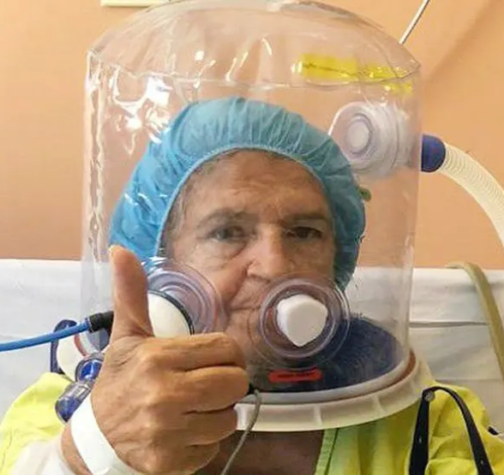
TECHNOLOGY TRANSFER OFFICE
These two transfer cases are: Natchup - 2018 (a sauce based on pumpkin, acerola and beetroot and Elmo - 2021 (an assisted breathing helmet that saved thousands of lives in the covid-19 pandemic)

Slide 10
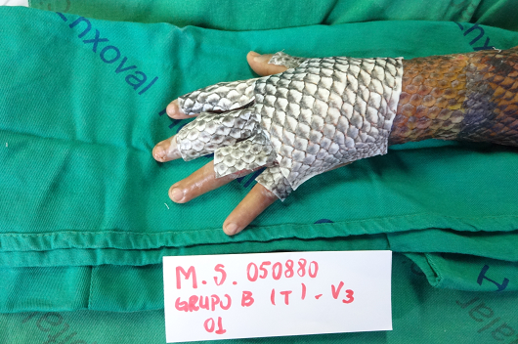
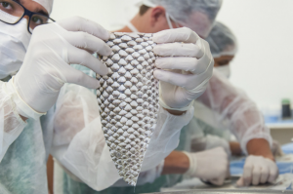
TECHNOLOGY TRANSFER OFFICE
SUCCESS CASE: research on tilapia skin (4 patents in Brazil and abroad) is being negotiated now
UFC-backed tilapia skin research finds applications in dentistry, nutrition, cosmetics and over a dozen other medical specialties
Launched in 2015, studies with tilapia skin have led to the formulation of several products, with other laboratory trials already underway

Slide 11
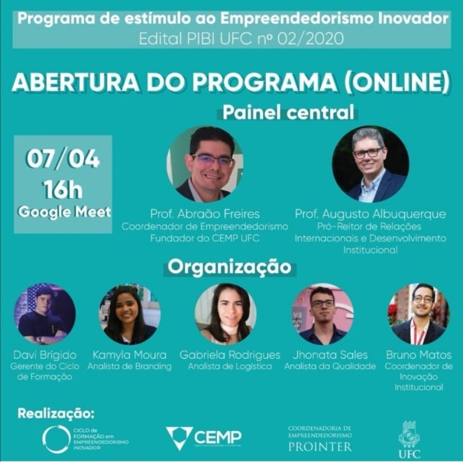
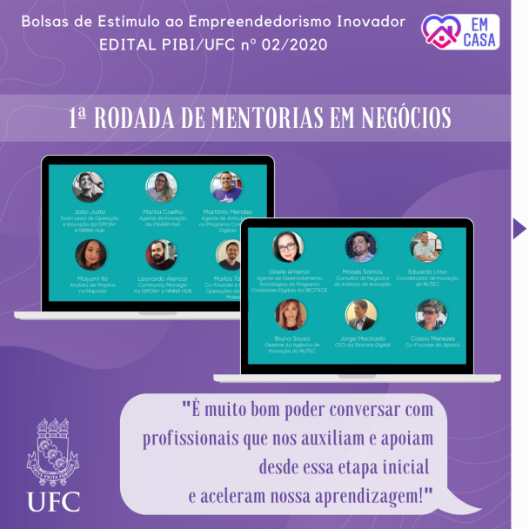
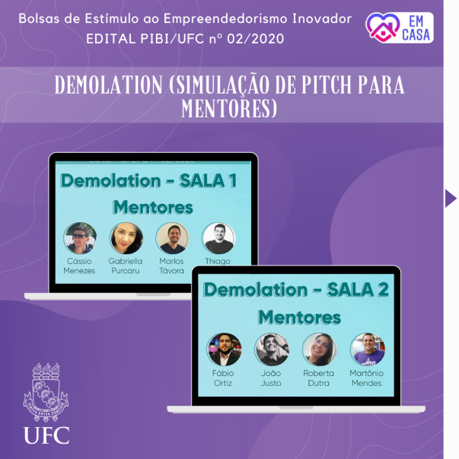
350+ Innovating Entrepreneuship Scholarships (90 / year)
160+ Startup Projects
700+ participants (scholarship holders, volunteers, supervising faculty and administrative staff)
18-week training cycles in Innovative Entrepreneurship + participating in the StartupCE program (sponsored by SEBRAE)
120h+ in business-oriented training programs
200+ connections established with entrepreneurs, investors, industry experts and mentors
Widespread access to coworking spaces
BRL 1.200.000,00+ invested in scholarships

Slide 12
OPEN INNOVATION PARTNERSHIPS
TECHNOLOGICAL DUE DILIGENCE

Slide 13
Innovation Challenge
Innovating in low-tech.
within the SDG challenges: No Poverty and Economic Growth

Slide 14
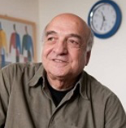
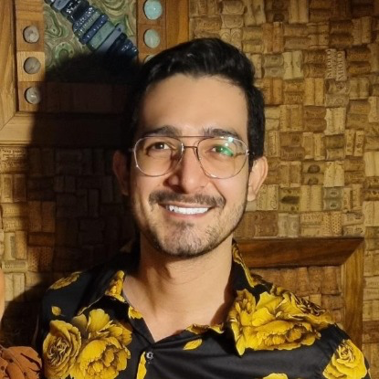
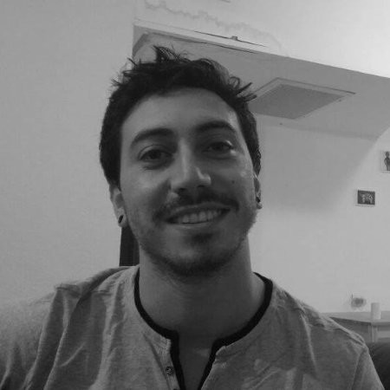
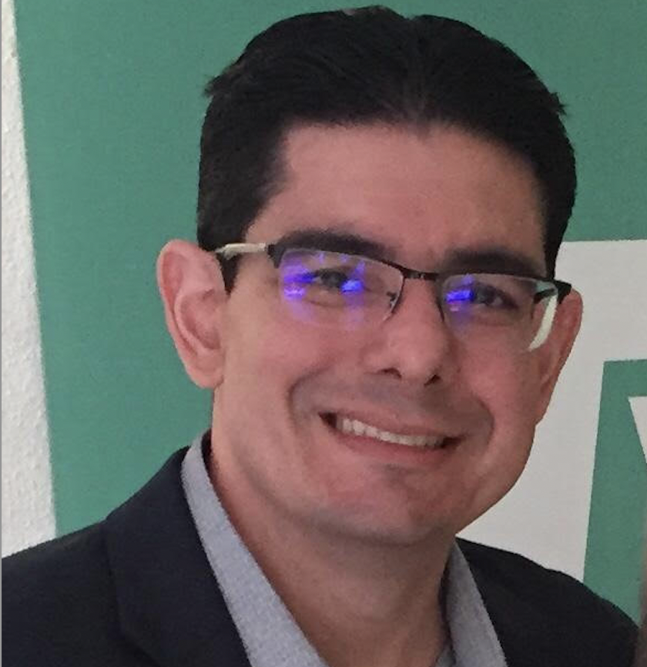
Professor Team
Raphael Bar-El
BGU
Bruno Matos
UFC
Liran Maymoni
BGU
Abraão Saraiva
UFC

Slide 15
The journey

Slide 16
The journey
Mar 07th
Mar 08th
Post Mar 08th
April
Student applications
Preparation of the event
Warm up
Preliminary meeting with students from both Universities
Innovation
Seminar
Development
Free development of the assingnment by teams
Mentoring 1
Check in with teams and professors

Slide 17
The journey
May
June 05th
June 09th
July
Mentoring 2
Check in with teams and professors
Ideas and presentation must be almost ready
Presentation
by Teams
Best solution
Winning Team
Announcement
Presentation on Innovation Roundtable
At UFC
Fortaleza

Slide 18
Challenge
Goals

Slide 20
Goal
To develop collaborative, innovative proposals for increasing productivity, inclusion and income, as well as reducing economic and social regional gaps in the selected areas of interest, based on a comparison between the experiences in Israel and Brazil, the global trends, and the prevailing global technologies.

Slide 21
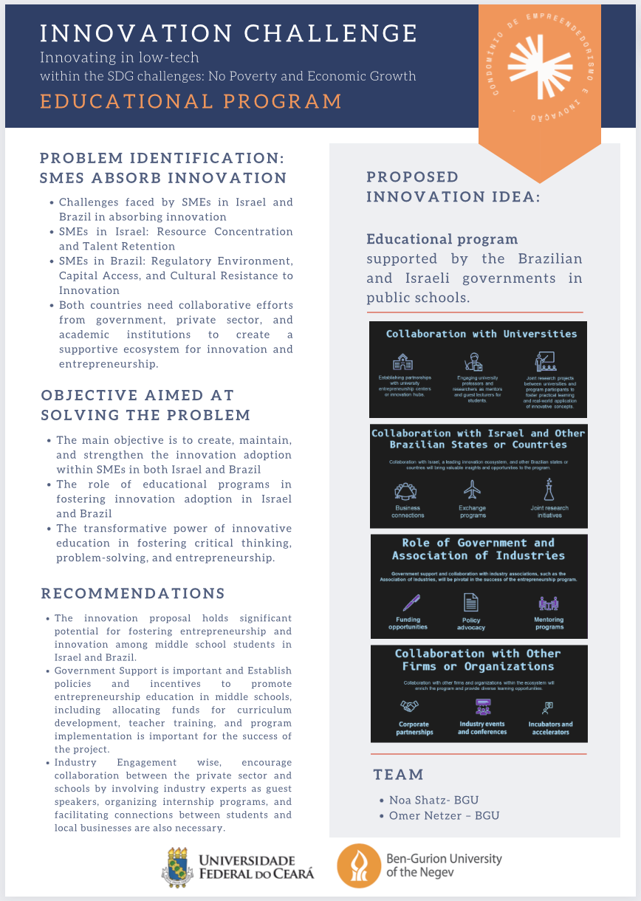
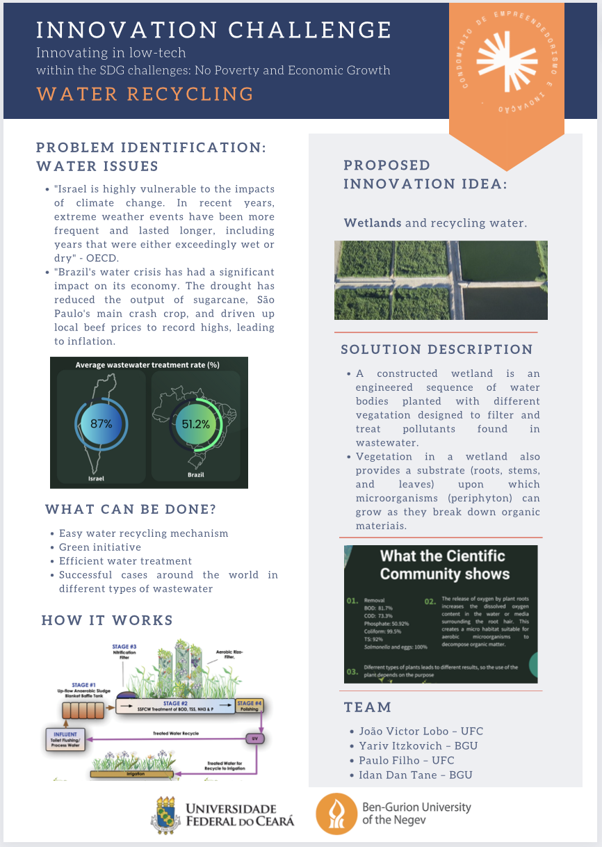

Slide 22
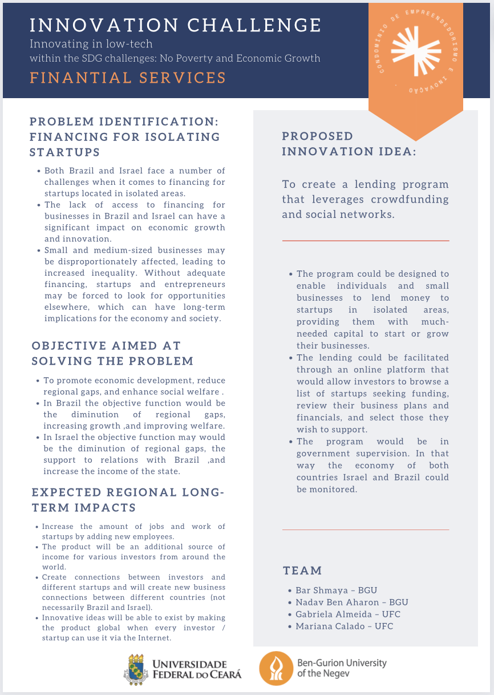

Slide 23
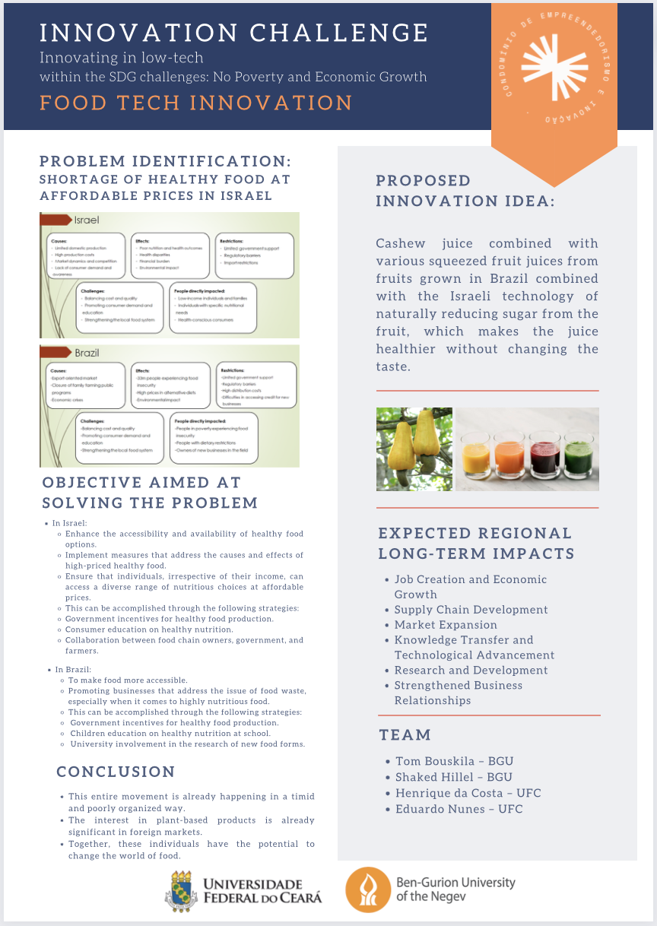

Slide 24
