Slide 1
LEADERS Project
Mosi Rosenboim
20/7/23

Slide 2
What is LEADERS?
An academic program for outstanding students
We aim to develop the next generation of Entrepreneurial leaders
Students from all faculties
At the last year of their undergraduate studies
Notes:
תוכנית אקדמית לסטודנטים מצוינים- בהמשך לדבר על ההבדל בין מצטיינים למצוינים
So – What is Leaders ?
Leaders is an excellence academic program done jointly by the Yazamut 360 center and the Gilford Glazer faculty of Business & Management
We highly believe in the importance of multidisiplimnnarty to Entrepreneurship and therefore we opened the program to all faculties and departments
The program is aimed to undergraduate students as we try to `

Slide 3
ALUMENI
LEADERSHIP
INNOVATION
ECOSYSTEM
Notes:
לאורך התוכנית כל סטודנט מקבל שלושה מרכיבים:
יזמות השפעה ומנהיגות.
בסוף ההשפעה היא דרך הרשת. זה לתמיד

Slide 4
LEADERS Program
Academic
Inspiration
Hands-On
Empowerment
Notes:
8 נקודות זכות אקדמיות בפקולטה לניהול
מרצים מובלים מהתעשייה ומהאקדמיה. ידע ברמת מאקרו וברמת מיקרו
עבודה על פרוייקטים שלהם
לווי אישי והעצמה של המשתתפים בכלים

Slide 5
Learning By Doing
Projects
Notes:
אחד הדברים שהשתנה לאורך השנים הוא החשיבות של המרצה במהלך תהליך הלמידה.
בעבר המרצה היה צריך לקחת 95% מהזמן של הכיתה.
היום הלמידה צריכה להיות יותר מעשית. התלמדים רוצים לדבר יותר, והסבלנות שלהם להקשיב ולשמוע קצרה מאוד.
הם חיים בעולם של תיק טוק.
8 שניות וזהו.
לכן לידרס מבוססת על למידה תוך כדי עשייה.

Slide 6
Structured Selection process
VS
Notes:
מחפשים סטודנטים מצויינים לא בהכרח מצטיינים
he difference between excellent students and outstanding students lies in the degree of their performance and achievements in their academic pursuits and beyond. Both are commendable categories, but there are subtle distinctions:
Performance Level:
Excellent Students: These students consistently perform at a high level in their studies, scoring top grades and demonstrating a thorough understanding of the subjects they study. They meet or exceed the expectations set by their teachers and show a strong grasp of the material.
Outstanding Students: These students go beyond simply meeting expectations; they consistently surpass them. They excel not only in academics but also in other areas, such as extracurricular activities, leadership, community involvement, and creative endeavors.
Consistency:
Excellent Students: They maintain high levels of performance over time, and their excellence is evident in their day-to-day work and assignments.
Outstanding Students: Their exceptional performance is not limited to one subject or area; they consistently excel across various disciplines or aspects of their lives.
Initiative and Innovation:
Excellent Students: They show dedication and determination in their studies, completing assignments with precision and thoroughness.
Outstanding Students: They not only display dedication but also demonstrate a proactive attitude towards learning. They may take the initiative to explore advanced topics, conduct independent research, or come up with innovative solutions to problems.
Impact and Recognition:
Excellent Students: They are often recognized and appreciated by their teachers and peers for their high-quality work and academic achievements.
Outstanding Students: Their achievements extend beyond the classroom, making a notable impact on their school, community, or even at a larger scale. They may receive awards, scholarships, or invitations to prestigious programs or events.
Leadership and Influence:
Excellent Students: While they may excel individually, their leadership or influence might be limited to certain areas or groups.
Outstanding Students: They have a broader influence, inspiring and positively influencing others around them. They may take on leadership roles in school clubs, teams, or community organizations.
In summary, while both excellent students and outstanding students are high achievers, outstanding students distinguish themselves through their consistent, exceptional performance across various domains, their proactive and innovative approach to learning, and their broader impact on their environment and community.

Slide 7
An Accelerator for Entrepreneurs
Notes:
אנחנו מתעניינים ביזם ולא בהכרח במיזם
לווי אישי
מנטור אישי
כלים

Slide 8
Innovative teaching methods
Real-life case study
Students teaching students
Lecturers diversity
International activity- joint activity with Prime students (Brown University)
Notes:
Master in Innovation Management & Entrepreneurship, PRIME, is a STEM Masters of Science (ScM) degree based in Brown's School of Engineering

Slide 9
LEADERS Program
From Innovation to Entrepreneurship
Start-Up Garage
Trends & Disruptive technologies
Workshops
Business strategy
Venture building toolbox
Semester A
Semester B
Semester c
OCT
NOV
DEC
JAN
MAR
APR
MAY
JUN
JUL
AUG
SEP
Academic Knowledge
Hands-On
Academic
Inspiration
Academic
Empowerment
Academic
Hands-On
Inspiration
Hands-On
Inspiration
Hands-On
Leadership & Empowerment
Notes:
שלושה סימטסרים
בסמסטר הראשון הם מקבלים ידע בנושאים של חדשנות ויזמות
וכן מידע על טרנדים וטכנולוגיות משבשות.
בסמסטר השני הם מקבלים כלי ניהול- כל הקורסים של ניהול כל אחד במפגש או שניים.
לאחר מכן מקבלים כלים לבניית עסק. רגולציה, משפט, גיוס כסף ועוד
בקיץ עורכים סדנה מרוכזת של שבוע ובו מקבלים מאיץ לעסק. הם לומדים משא ומתן, מצגות וכו. בסוף יש אירוע מול משקיעים שמקבלים תקציב וצריכים להשקיע במיזמים של הסטודנטים

Slide 10
Added Values:
Personal development
Hands-on experience
An entry card to the “real world”
Academic knowledge
Personal Branding and Networking
Become a LEADER

Slide 11
LEADERS by Numbers
30 excellent students
4 Academic courses (8 points)
15 workshops
6 Ventures
250 hours (formal) +10h personal mentorship
25 external lecturers
2 Student’s ventures funded by Cactus
3 Student’s groups participated at Google Innovation competition
And more….

Slide 12
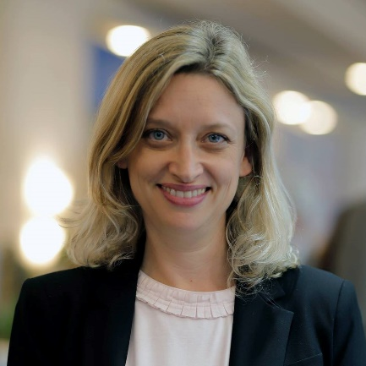
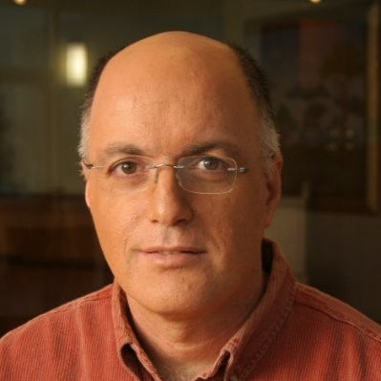
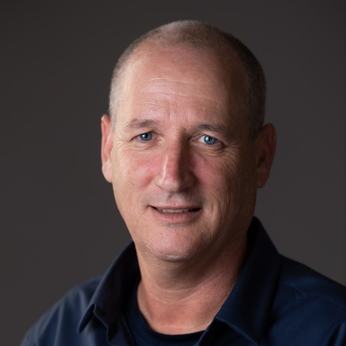
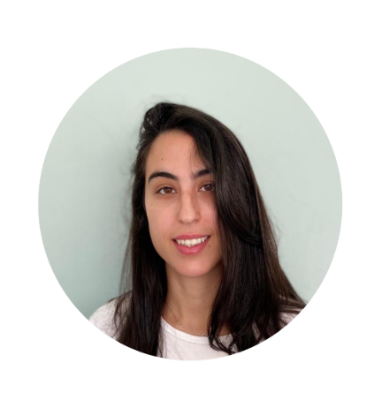
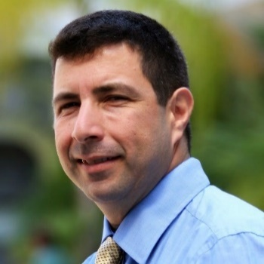
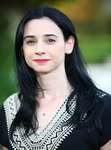
The Team
DANA GAVISH-FRIDMAN
Head of “Yazamut360”
Prof. CARMEL SOFER
Chairman of “Yazamut360”
Prof. MOSI ROSENBOIM
GGFBM Chairperson
ARAVA REFAEL
LEADERS Operational Manager
GADI BAHAT
Executive director LEADERS
Dr. STAV ROSENZWEIG
GGFBM Academic consultant
LUCIANA SELLAM
GGFBM Head of Administration

Slide 13
With a lot of help and support :
Full support of BGU Management
Backwind from BGU Departments
Personal help of BGU’s leading staff
12 Month …..

Slide 14
MBA P

Slide 15
What is MBAIP?
An academic program for international students
We aim to develop the next generation of managers
One year
Project base curriculum

Slide 16
Notes:
לאורך התוכנית כל סטודנט מקבל שלושה מרכיבים:
יזמות השפעה ומנהיגות.
בסוף ההשפעה היא דרך הרשת. זה לתמיד

Slide 21
Raising capital and investors
Applied Strategic Analysis (case studies competition)
Negotiations & Conflict Management workshop
Practical methodologies for managers - The Social Challenge
Semester C
Behavioral Science
Personal Branding
Story Telling
Intellectual Property and Patents
Innovative Financial Strategies for Rising Money and Growing Businesses
Strategy and marketing for managers
Semester B
Accounting for Managers
Customer Discovery
Between Entrepreneurship, Leadership, and Management
Marketing - Part 2
Networking
Product Market Feet
Social and economic dilemmas
Semester A
Projects Management
Data-Driven Decision Making for Innovation
Markets Research
Techniques for generating and refining ideas and methods
Innovation Management & Strategy &Ecosystem
Creative thinking

Slide 22
Creative thinking
Social and economic dilemmas
Projects Management
Markets Research
Introduction to Innovation and Entrepreneurship (Tech7)
Between Entrepreneurship, Leadership and Management (Granit)
Accounting for Managers
Behavioral Science for Managers
Financial Management
Marketing Simulation WORKSHOP
Strategy and marketing for managers
Raising capital and investors
Applied Strategic Analysis (case studies competition)
Negotiations & Conflict Management workshop
Practical methodologies for managers - The Social Challenge

